Slide 1
CB1-Practice of microscope questions

Slide 2
Problem solving about the microscope
Remember the logic and the basic facts!
The apparent size is much larger than the real size.
The overall magnification of a microscope can be calculated by timing the power of the lenses (NOT ADDING!)
If your answer has too many zeros, then you will be asked to change unit.
There is a lot of micrometers in a millimeter, therefore, to obtain micrometers from millimeters, you will have to convert that number of millimeters to a much bigger number, i.e. time it by 1000.
It is vice-versa to obtain a number of millimeters from micrometers, i.e. divide the number of micrometers by 1000.
The field of view is what you see through the microscope, sometimes you are given its diameter and that is very useful!
2mm

Slide 3
Question 1.
Question: A microscope has a X4 eye piece lens and a X100 objective lens. A cell’s length is 0.2μm, what will be its apparent size?
Break down the problem in 3 steps.

Slide 4
Question 1.
Question: A microscope has a X4 eye piece lens and a X100 objective lens. A cell’s length is 0.02μm, what will be its apparent size in mm?
The 3 steps for this question are:
- finding out the total magnification
- finding the size of the apparent length from the actual size and the magnification
- converting the result from μm to mm.

Slide 5
Question 1.
Question: A microscope has a X40 eye piece lens and a X100 objective lens. A cell’s length is 2μm, what will be its apparent size in mm?
finding out the total magnification
40X100 = X4000
Finding the apparent length from the actual size and the magnification
(Apparent size always expected to be bigger)
2X4000 = 8000μm
- converting the result from μm to mm.
(Get rid of extra “0s”, can only be done by dividing the number)
8000 ÷ 1000 = 8mm

Slide 6
Question 2.
Question: A microscope has a X2 eye piece lens and a X10 objective lens. Five length of cells fit in the field of view with a diameter of 3mm. What is the apparent length of 1 cell in mm?
First, break down the problem in 3 steps.

Slide 7
Question 2.
Question: A microscope has a X2 eye piece lens and a X10 objective lens. Five length of cells fit in the field of view with a diameter of 3mm. What is the apparent length of 1 cell?
The 3 steps for this question are:
- finding out the total magnification
- finding the real size of one cell from the number of cells that can fit in the diameter of he field of view.
- finding what would be the apparent size of that cell when taking into account the magnification

Slide 8
Question 2.
Question: A microscope has a X2 eye piece lens and a X10 objective lens. Five length of cells fit in the field of view with a diameter of 3mm. What is the apparent length of 1 cell?
The 3 steps for this question are:
- finding out the total magnification
- finding the real size of one cell from the number of cells that can fit in the diameter of he field of view.
- finding what would be the apparent size of that cell when taking into account the magnification

Slide 9
Question 2.
Question: A microscope has a X2 eye piece lens and a X10 objective lens. Five length of cells fit in the field of view with a diameter of 3mm. What is the apparent length of 1 cell?
finding out the total magnification:
2 X 10 = X20
finding the real size of one cell from the number of cells that can fit in the diameter of he field of view.
3 ÷ 5 = 0.6 mm
finding what would be the apparent size of that cell when taking into account the magnification
0.6 X 20 = 12 mm

Slide 10
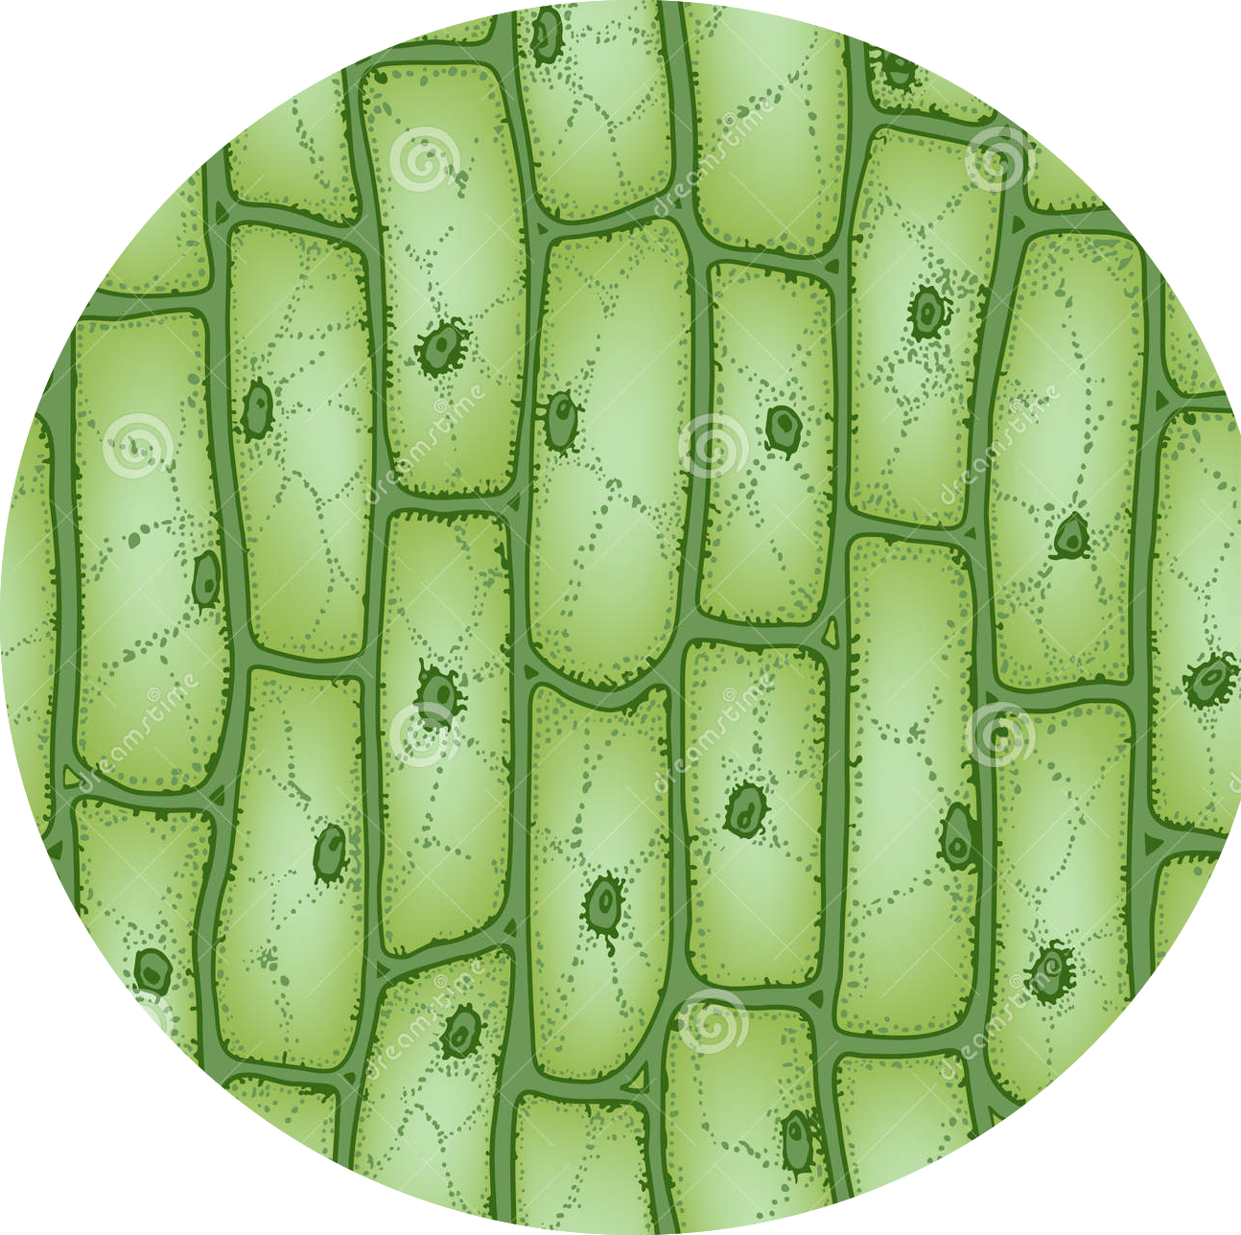
Question 3.
Question: estimate the average length of
a cell.
0.2 μm
First, breakdown the problem in 2 steps.

Slide 11
Question 3.
Question: estimate the average length of
a cell.
0.2 μm
Finding the diameter of the field of view:
0.2 X 5 = 1 mm
Estimating the diameter of one cell:
1 ÷ 3 = 0.3 mm

Slide 12
Question 4.
Question: if a cell appear to be 10mm in length when looking through a microscope which magnifies by X300,
what is its actual size in μm.
First, breakdown the problem in 2 steps.

Slide 13
Question 4.
Question: if a cell appear to be 10mm in length when looking through a microscope which magnifies by X300,
what is its actual size in μm.
Finding how much smaller is the actual size of the cell?
10 ÷ 300 = 0.3 mm
Converting the answer to μm:
0.3 X 1000 = 300 μm

