Slide 1
CfE Higher Biology Unit 1: DNA and the Genome
Chapter 4: Genome and mutations

Slide 2
Structure of the genome
The Genome consists of all the hereditary information encoded in DNA.
There are sequences of bases which code for proteins (genes), but there are many sequences which are non-coding.
The non-coding sequences regulate transcription or are transcribed but not translated. ( rRNA/ tRNA/ mRNA)

Slide 4
Mutation
A change in the structure or amount of an organism’s genetic material

Slide 5
Frequency of mutation
In the absence of outside influences gene mutations occur spontaneously, and at random, but only occur rarely.
Most mutant alleles are recessive, and so are rarely expressed in the phenotype (i.e. only when homozygous, or when sex-linked).

Slide 6
Mutagenic agents
These can artificially increase the rate of mutation:
Radiation (including uv)
Some chemicals e.g. mustard gas.

Slide 7
1. Gene Mutations
Definition: a change in one or more of the nucleotides in the DNA sequence.
These can be nucleotide substitutions, insertions or deletions. SID

Slide 8
Gene Mutations: Substitution

Slide 9
Gene Mutation: Insertion

Slide 10
Gene Mutation: Deletion

Slide 11
Sickle cell anaemia – caused by a substitution mutation

Slide 12
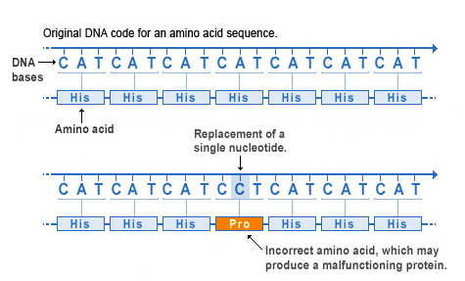
Substitution of a single nucleotide

Slide 13
Insertion of a single nucleotide

Slide 14
Deletion of a single nucleotide

Slide 15
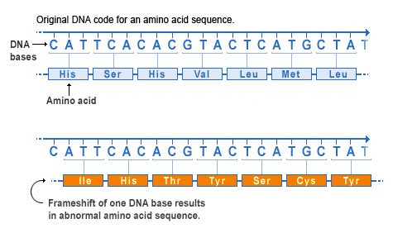
Frameshift Mutations: Insertion and Deletion

Slide 16
Missense mutation: a different Amino Acid is inserted

Slide 17
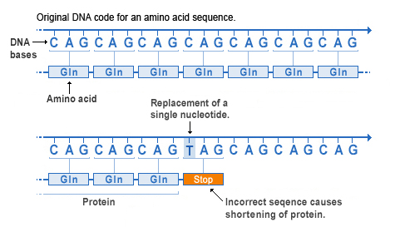
Nonsense mutation: a STOP codon is formed

Slide 18
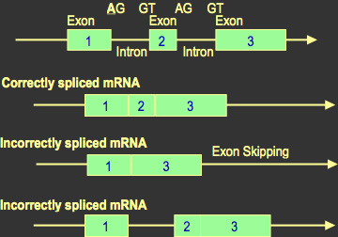
Splice-site mutation: results in some introns being retained and some exons not being included in the mature RNA transcript.

Slide 19
Chromosome Mutations
Definition: a change in the number or sequence of genes in a chromosome.
TIDD

Slide 20
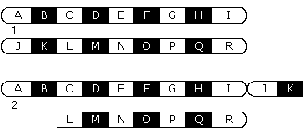
Chromosome mutation: Translocation. Part of a chromosome attaches to a non-homologous chromosome

Slide 21
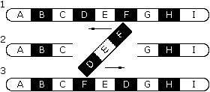
Chromosome mutation: inversion. Rotation of a segment of DNA through 180 degrees

Slide 22
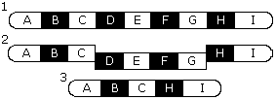
Chromosome mutation – Deletion. A portion of chromosome is lost.

Slide 23
b) Chromosome mutation: Duplication. A section of chromosome is repeated on its homologue

Slide 24
Why are Mutations and Gene Duplication Important in Evolution?
Duplicated genes cans still synthesise proteins, but there is the opportunity for beneficial mutations to occur and natural selection to operate leading to evolution.

