Slide 1
CfE Higher Biology Unit 1: DNA and the Genome
Gene Expression

Slide 2
DNA to proteins is the expression of genes.
transcription
translation
DNA
RNA
Protein
replication

Slide 3
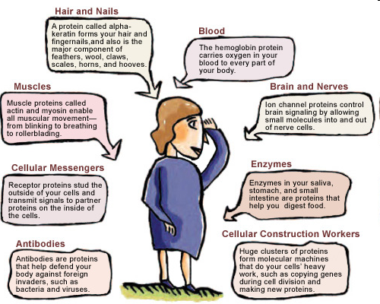

Slide 4
All proteins are contain the elements:
Carbon (C)
Hydrogen (H)
Oxygen (O)
Nitrogen (N)
And sometimes Sulphur (S)

Slide 5
The subunits of proteins are amino acids.
There are 20 different types of amino acid.
The length of a protein molecule varies from a few amino acids to many thousands.

Slide 6
Amino acids are the building blocks of proteins

Slide 7
Primary structure: Amino acids are linked together by peptide bonds

Slide 8
Secondary structure: Hydrogen bonds form between certain amino acids in a polypeptide chain

Slide 9
Comparing DNA with RNA…….
DNA is a double stranded molecule, where RNA is single stranded.

Slide 10
Transcription AND Translation
Protein Synthesis occurs in two stages:

Slide 11
RNA has a different structure from DNA. RNA uses the base uracil. DNA uses the base thymine.

Slide 12
The sugar deoxyribose in DNA is replaced by ribose in RNA
phosphate
base
ribose sugar in RNA
deoxyribose sugar in DNA

Slide 13
Transcription
The synthesis of mRNA strand from a section of DNA

Slide 14
DNA Transcription
DNA double helix ____________
Weak ____________ bonds between bases break, separating the two DNA strands
Free _______ nucleotides pair with their complementary base pair on the ________ strand. Weak hydrogen bonds form between _________ ___________.
Strong chemical bonds form between the _______ and _________ of neighbouring nucleotides.
A strand of messenger RNA has now been made

Slide 15
Excellent animation of transcription
https://www.youtube.com/watch?v=HWzKxp8I-VU

Slide 16
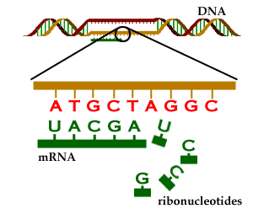
Transcription of mRNA
The copying of the genetic code using the free RNA nucleotides present in the nucleus to form messenger RNA

Slide 17
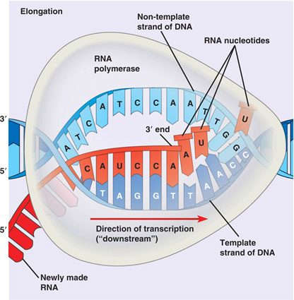
Transcription is carried out by the enzyme RNA polymerase

Slide 18
RNA polymerase can only add nucleotides to the 3’ end of the growing mRNA molecule.
The mRNA strand is called primary transcript of mRNA.

Slide 19
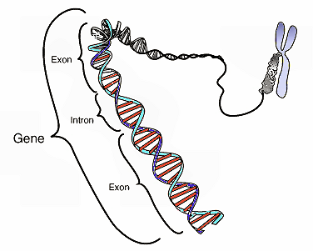
Modification of Primary Transcript
In eukaryotes long stretches of DNA exist which do not code for proteins – called introns.
Coding regions are called exons

Slide 20
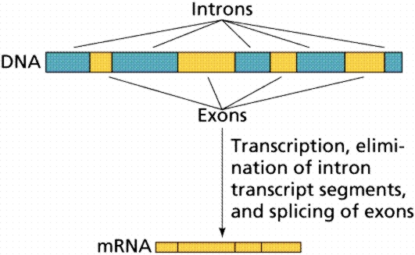
Splicing
The introns are cut out and removed from the primary transcript of mRNA and the exons are spliced together to form mRNA with sequences of nucleotides coding for proteins.

Slide 21
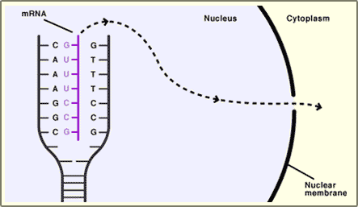
The mRNA then passes out of the nucleus via a pore in the nuclear membrane into the cytoplasm

Slide 22
Translation
The synthesis of protein as a polypeptide chain under the direction of mRNA
Occurs on ribosomes in the cytoplasm.

Slide 23
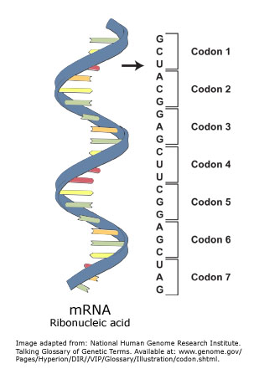
Each triplet of bases on mRNA is called a codon; each codon codes for an amino acid.

Slide 24
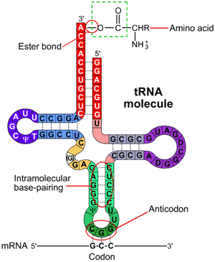
Transfer RNA (tRNA) is found in the cytoplasm and carries a triplet of bases called an anticodon
Each anticodon corresponds to a particular amino acid, carried by the tRNA at its attachment site

Slide 25
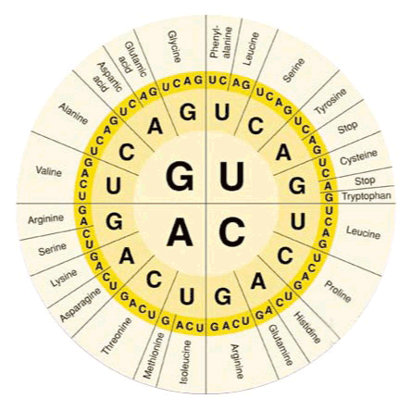
Each codon on the mRNA codes for a particular amino acid

Slide 26
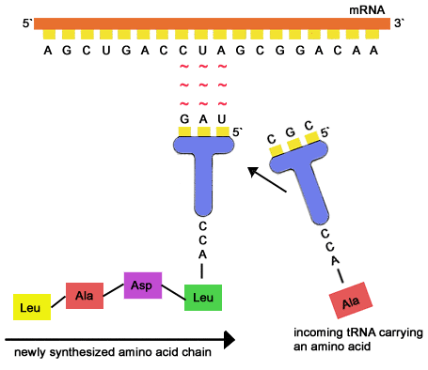
The anticodon on the tRNA molecule forms bonds with the corresponding codon on the mRNA

Slide 27
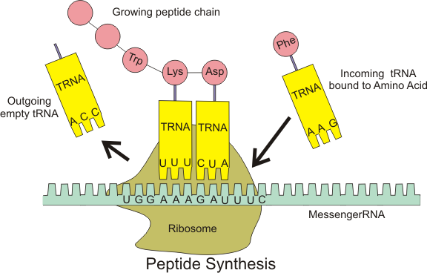
The ribosome contains enzymes essential for protein synthesis

Slide 28
Translation
mRNA binds to the ribosome.
tRNA molecule picks up its appropriate amino acid from the cytoplasm
The tRNA carries the amino acid to the ribosome and becomes attached.

Slide 29
Translation
When the first two amino acids molecules are next to each other they join with a peptide bond.

Slide 30
Translation
The process is repeated many times , thus translating the mRNA into a complete polypeptide chain.

Slide 31
From DNA to protein
Excellent! Animation of Protein Synthesis
https://www.youtube.com/watch?v=gG7uCskUOrA
Animation with good narration – general transription and translation
http://www.youtube.com/watch?v=D3fOXt4MrOM&feature=fvwrel
McGraw Hill ribosome translation incl. binding sites – animation + narration (excellent)
http://highered.mcgraw-hill.com/sites/0072507470/student_view0/chapter3/animation__how_translation_works.html

Slide 32
One gene can code for many proteins
Particular exons of a gene may be included, or excluded from the mature transcript of mRNA.
This allows many different proteins to be synthesised using the same gene.
This is known as alternative RNA splicing.

Slide 33
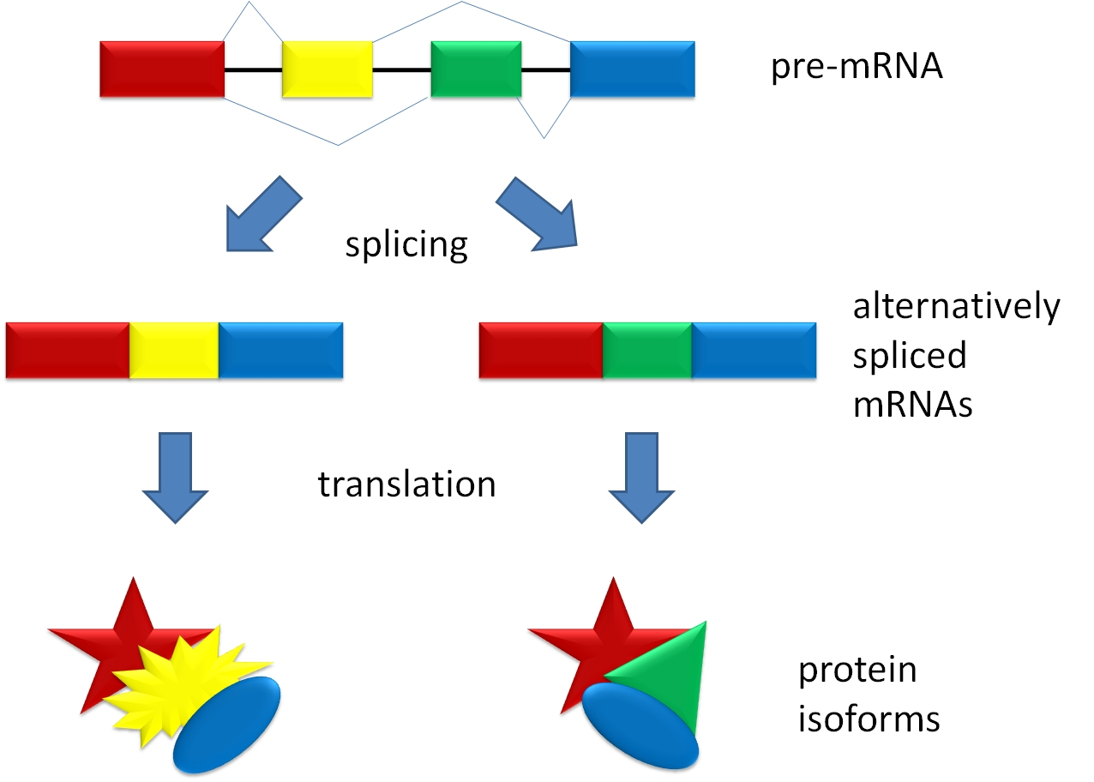
Alternative RNA splicing

