Slide 1
Electricity For the wee ones….

Slide 2
The purpose of this workshop is to understand what electrical current is.

Slide 3
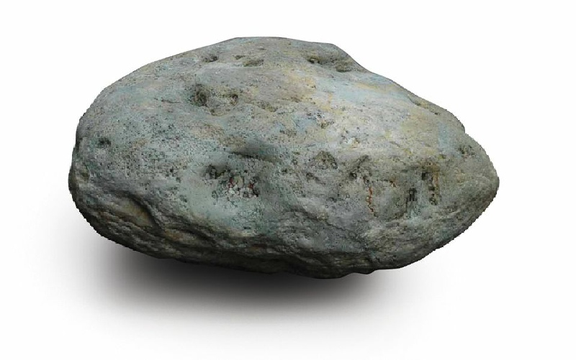
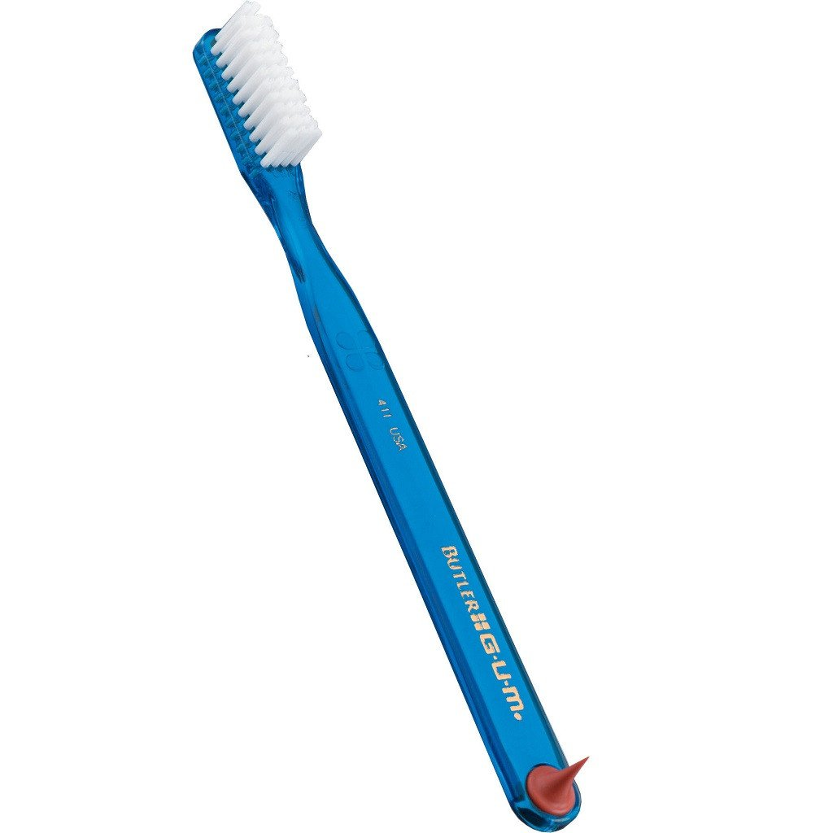
Which of these objects can move a piece of metal without touching it?

Slide 4
The magnet!

Slide 5
Do you know what is inside a piece of metal?

Slide 6
+
+
+
+
+
+
e
e
e
+
e
e
+
+
+
+
+
e
e
e
e
+
+
+
+
+
+
e
e
e
+
+
+
+
+
+
e
e
e
e
+
+
e
+
+
+
e
+

Slide 7
+
+
+
+
+
+
e
e
e
+
e
e
+
+
+
+
+
e
e
e
e
+
+
+
+
+
+
e
e
e
+
+
+
+
+
+
e
e
e
e
+
+
e
+
+
+
e
+

Slide 8
+
+
+
+
+
+
e
e
e
+
e
e
+
+
+
+
+
e
e
e
e
+
+
+
+
+
+
e
e
e
+
+
+
+
+
+
e
e
e
e
+
+
e
+
+
+
e
+

Slide 9
Inside metal, there are tiny little
things. Some are called atoms (in black), some are called electron (in white).
When you bring the magnet close to a piece of metal, the all piece moves but inside it, the little electrons move too.
+
+
+
+
+
+
e
e
e
+
e
e
+
+
+
+
+
e
e
e
e
+
+
+
+
+
+
e
e
e
+
+
+
+
+
+
e
e
e
e
+
+
e
+
+
+
e
+

Slide 10
Inside metal, there are tiny little
things. Some are called atoms (in black), some are called electron (in white).
When you bring the magnet close to a piece of metal, the all piece moves but inside it, the little electrons move too.
+
+
+
+
+
+
e
e
e
+
e
e
+
+
+
+
+
e
e
e
e
+
+
+
+
+
+
e
e
e
+
+
+
+
+
+
e
e
e
e
+
+
e
+
+
+
e
+

Slide 11
+
+
+
+
+
+
+
+
+
+
+
+
+
+
+
+
+
+
e
e
+
+
+
+
+
+
e
e
e
e
e
e
+
+
+
+
+
+
e

Slide 12
Now, lets look at something different!

Slide 13
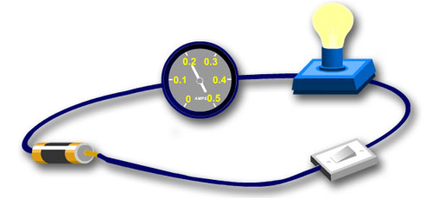
What do you think is shown by the movement of the needle on this piece of equipment?
The movement of the needle shows that electrical current is passing in the circuit!

Slide 14
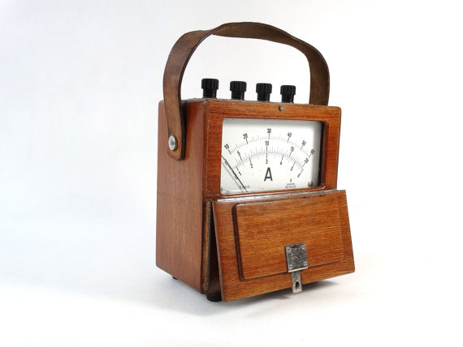
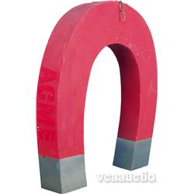
Do you think that waving the metal wire beside the magnet will produce electrical current?

Slide 15
+
+
+
+
+
+
+
+
+
+
+
+
e
e
e
e
e
e
e
e
+
e
e
+
+
+
+
+
+
+
+
+
+
+
e
e
e
e
e
e
e
e
+
+
+
+
+
+
+
+
+
+
+
+
e
e
e
e
e
e
+
+
+
+
+
+
+
+
+
+
+
+
e
e
e
e
e
e
e
e
e
e
e
+
e
e
+
+
+
+
+
+
+
+
+
+
+

Slide 16
Do you think that waving the metal wire in the other direction will also produce electrical current?
Do you think the needle will be doing exactly the same??

Slide 17
+
+
+
+
+
+
+
+
+
+
+
+
e
e
e
e
e
e
e
e
+
e
e
+
+
+
+
+
+
+
+
+
+
+
e
e
e
e
e
e
e
e
+
+
+
+
+
+
+
+
+
+
+
+
e
e
e
e
e
e
+
+
+
+
+
+
+
+
+
+
+
+
e
e
e
e
e
e
e
e
e
e
e
+
e
e
+
+
+
+
+
+
+
+
+
+
+

Slide 18
Will more current be generated by more coils in the wire?

Slide 19
Conclusion
Electrical current is made by the movement of small particles called electrons.
By coiling the wire, we generate more current!

Slide 20
About 30cm

Slide 21
Workshop 1
1- How do we generate electricity?
Simply by moving a magnet close to a coil of wire, or a coil of wire close to a magnet!
In the Faraday torch, a magnet moves in and out of a coil and a little battery stores up the current so that you can use the lamp without having to shake it all the time.
2- Experiment with wind-up torches.
- We have seen that the the greater the number of coils, the greater the current.
- Does the speed at which the magnet is moved by the wire affect how much electrical current is produced?
A torch in off position/timer/one helper per pair of kids
One kid to wind up torch twice slowly , then timer ready and torch switched on, time recorded for light to fade. Change kid, torch wound up fast for two turns. Timed again.(Hopefully, light for about 2min).
Results written on sheet- Results shared / Conclusion
Then prepare for competition, who can wind up light to shine for exactlyish 60s?
Competition with 10 kids pairs.
Kids wind up the torch when in switched-off position, then time are compared to see who has won!

Slide 22
How long does the torch shine for?
How long does the torch shine for?
 | Time (Seconds)
Slow wind-up
Fast wind-up
 | Time (Seconds)
Slow wind-up
Fast wind-up

Slide 23
Workshop 2
How do particles move in a circuit?
Kids forming a ring at hand reach. One kid is the battery, another is the buzzer and another the switch (PHS pupil).
A pile of electrons (scrunched up papers) in a bucket in the center.
Kids tasked to show us how they think that the electrons move in the circuit. Buzzer told to buzz only if electrons are passing by him.
Then if mistake corrected.
Then video watched to assess the kids’ understanding.

Slide 24
Workshop 3
How do we generate light from electricity passing into a wire?
Kids provided by a few set-up with power supplies and a connected light bulb. At low power, the filament of the bulb glows dimly like lava, at higher power, the bulb is fully lit.
We can try to see if they can come up with an idea of how light is generated by electricity, friction of electrons in the wire heat up the filament, the same way friction of rubbing hands warms them up.

Slide 25
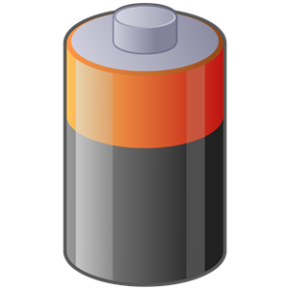

Slide 27
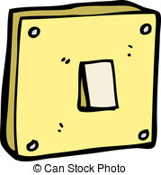

Slide 28
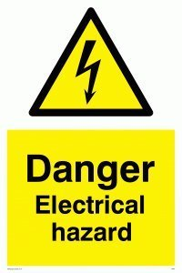
Prof.
Wind-up torch
Laboratory
Danger
wizard

