Slide 1
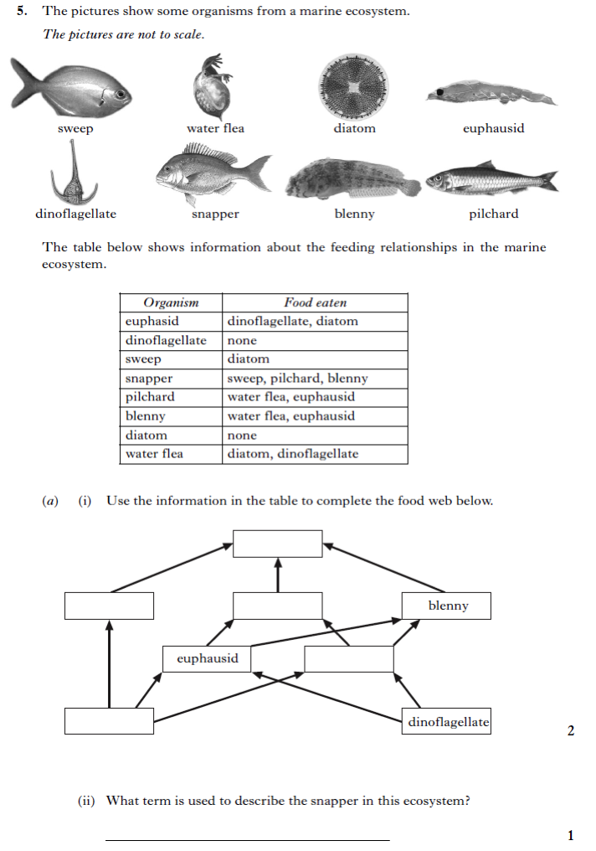
LE1 - Ecosystems
1

Slide 2
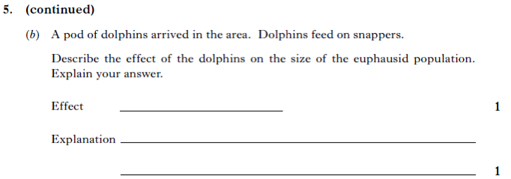
1
2
3

Slide 3
4

Slide 4
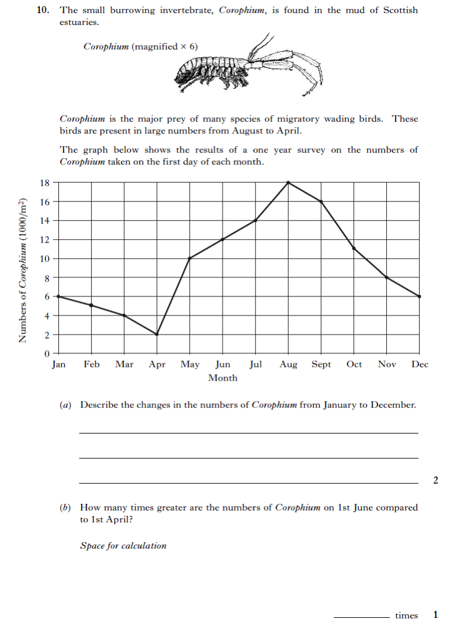
5

Slide 5
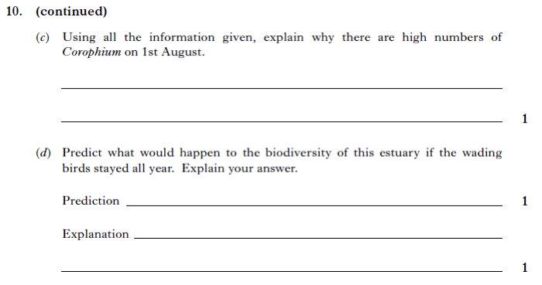
5
6
______________________________________________________________________________

Slide 6
7

