Slide 1
CfE Higher Biology Unit 1: DNA and the Genome
Chapter 3: Differentiation in Multicellular Organisms

Slide 2
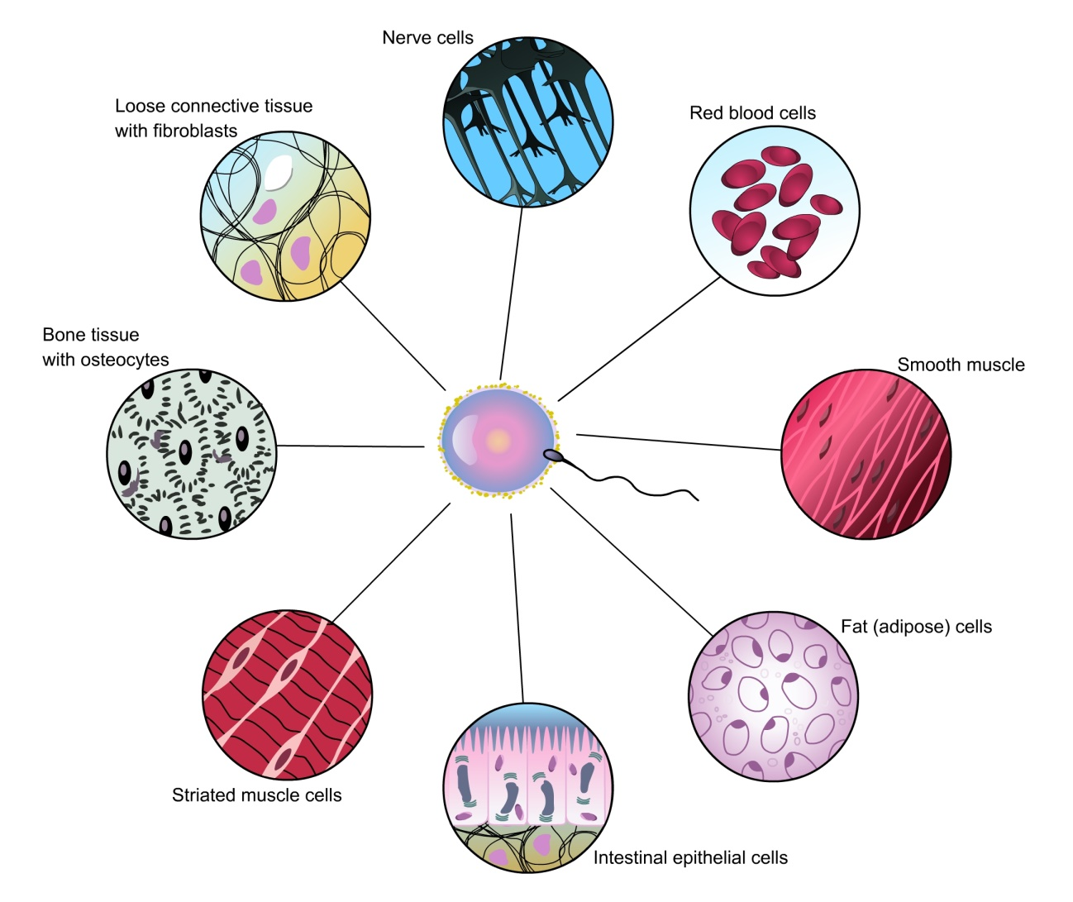
Differentiation
Differentiation is the process where unspecialised cells become altered to perform a special function.

Slide 3
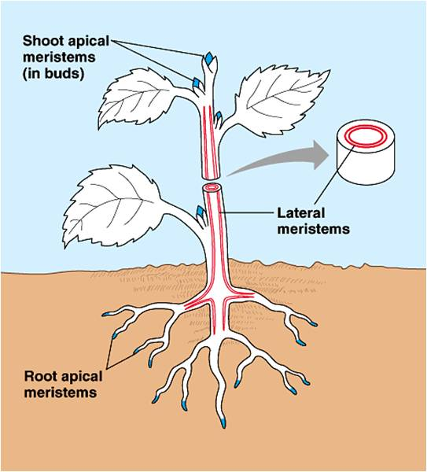
Meristems: regions of unspecialised cells in plants capable of repeated cell division or differentiation.

Slide 4
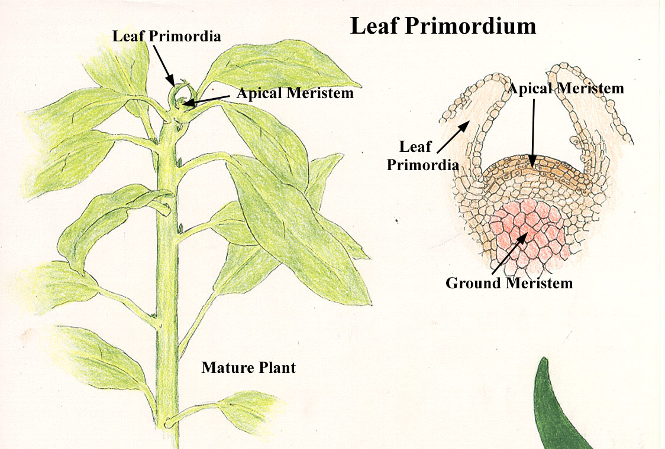
Apical meristem: tip of plants

Slide 5
Shoot apical meristem of Coleus

Slide 6
Root apical meristem of Zea mays

Slide 7
The Embryo
The genes in cells at this early stage are still switched on or have the potential to become switched on. They could become any sort of tissue the organism has evolved to form.
The cells are pluripotent.

Slide 8
Which embryo is human?
http://www.exploratorium.edu/exhibits/embryo/embryoflash.html

Slide 9
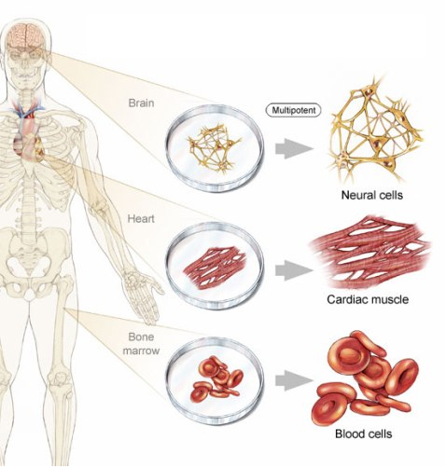
Differentiation
As development proceeds. The cells undergo differentiation and become specialised in structure, making them perfectly adapted for carrying out a particular function.

Slide 10
Differentiation
Once a cell becomes differentiated it only expresses the genes that code for the proteins specific to the workings of that particular cell.
For example
In a cell in the pancreas genes that code for the formation of insulin are switched on
In a cell in the salivary glands genes that code for the formation of saliva are switched on
In a goblet cell in the trachea genes that code for the formation of mucus are switched on

Slide 11
Research value of stem cells
https://www.youtube.com/watch?v=8JTw2RpDo9o Irish stem cell foundation – what are stem cells, and what can they do for us? (6 mins)

Slide 12
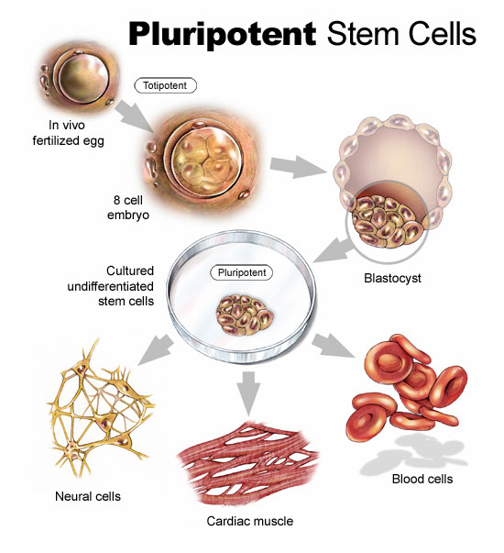
Research Value of Stem Cells
Given optimal culture conditions and provided with certain growth factors human stem cells can be grown rapidly.
Without these growth factors the stem cells will begin to differentiate.

Slide 13
Tissue Stem Cells
These have the ability to differentiate into a limited number of cell types according to the source system. They are multipotent.

Slide 14
Therapeutic and potential value of stem cell research

Slide 15
Ethical Issues:
Embryos used in stem cell research are currently destroyed after 14 days and have no possibility of life.
The source of embryos is from IVF treatment. More embryos are produced than are destined for implantation in the womb.
Should they be used in this way?

