Slide 1
LE2- Competition
1
2

Slide 2
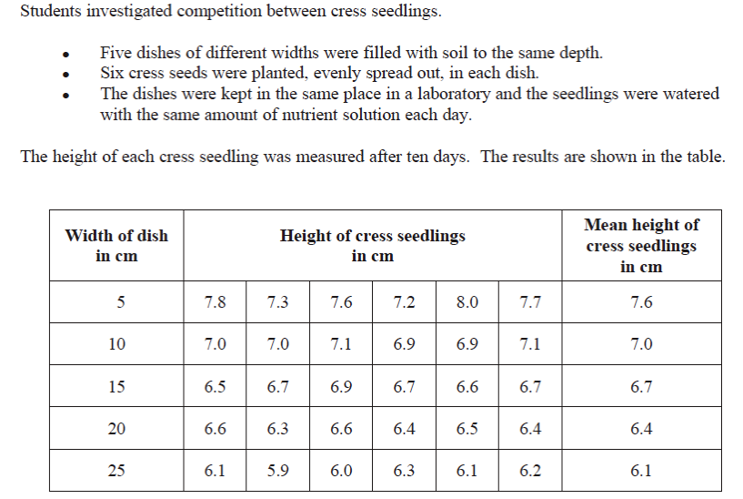
3

Slide 3
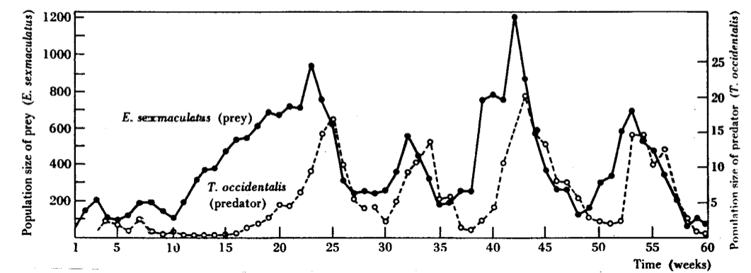
4
5
1/ When they reach their peak, roughly how many times greater is the population of the prey compared to that of the predator?
2/ What % increase is there in the population of the predator from time= 5 weeks to time= 25 weeks?
3/ Which curve is lagging behind? Is it that of the predator or that of the prey?

