Slide 1
Gene expression
What is gene expression?
In a cell, only a fraction of the genes are expressed at one time.
Gene expression is the process by which information from a gene is used in the synthesis of a functional protein.
If the DNA sequence determines the genotype, what is determined by proteins produced as a result of gene expression?
The phenotype

Slide 2
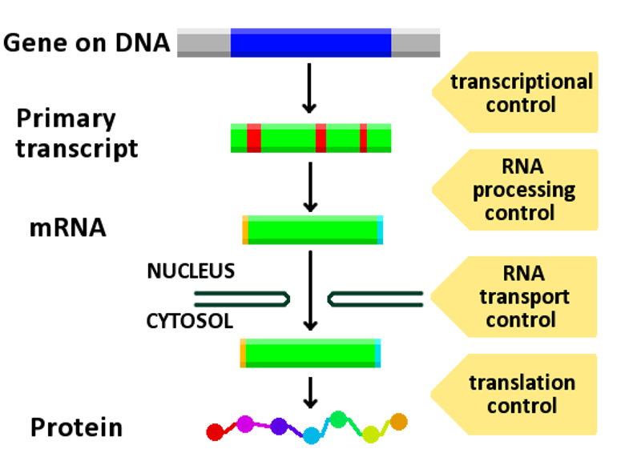
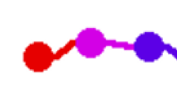
1
2
3
Mature
mRNA
Mature
protein
5
Protein
5
Polypeptide
4

Slide 3
Name of process?
Transcription
Splicing
Name of process?
Mature
mRNA
Mature
protein
5
Name of process?
Folding
Name of process?
Folding
Translation
Protein
Polypeptide

Slide 4
Transcription
http://www.educationscotland.gov.uk/highersciences/humanbiology/animations/transcription.asp

Slide 5
Translation
http://www.educationscotland.gov.uk/highersciences/humanbiology/animations/translation.asp

Slide 6
Characteristics of RNA
- RNA is single stranded
- RNA contains uracil instead of thymine
- RNA contains the sugar ribose rather than deoxyribose

Slide 7
How many types of RNAs du you remember?
mRNA
rRNA
tRNA

Slide 8
What is the function of mRNA?
Involved in transcription, carries a copy of the DNA code from the nucleus to the ribosome
What is the function of rRNA?
Associates with certain proteins to form ribosomes

Slide 9
What is the function tRNA?
Involved in translation, each tRNA carries a specific amino-acid.

Slide 10
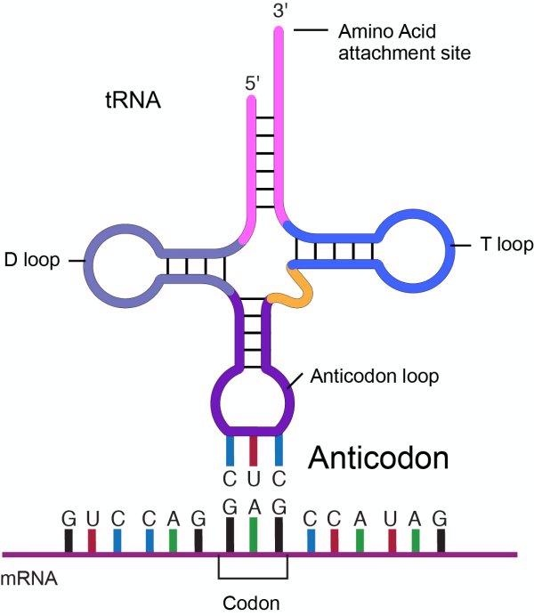
?
?

Slide 11
?
?

Slide 12
What causes the folding of tRNA?
Complementary base pairing.
What are the 2 important sites on a molecule of tRNA?
The anti-codon
The attachment site

Slide 13
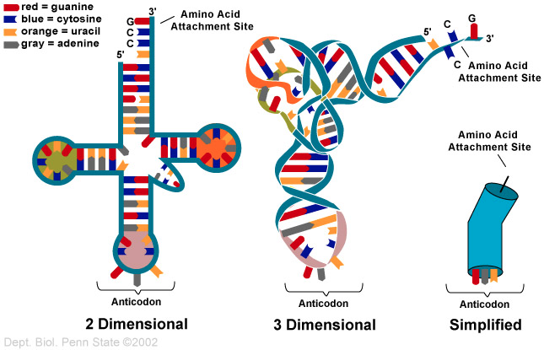

Slide 14
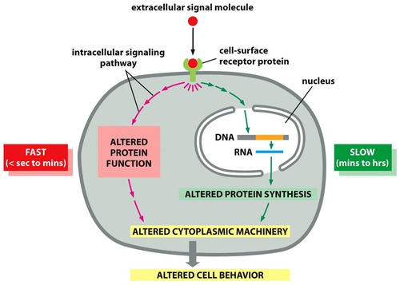
What influences gene expression?
Intra and extra-cellular environmental factors

Slide 15
What controls gene expression?
Regulation of both transcription and translation
Mature
mRNA

Slide 16
What is the process responsible to produce different protein from the same gene?
Alternative splicing

Slide 17
Animation

Slide 18
Structure of proteins
Simplest unit?
Amino acid
How are they joined?
Peptide bond
What type of bond is a peptide bond?
A strong covalent bond
Together, many amino acids joined by peptides bonds directly after translation form a ________________
polypeptide

Slide 19
Shape of proteins
What help proteins to be held in a three dimensional shape?
Peptide bonds
Hydrogen bonds
Interactions between individual amino-acids

Slide 20
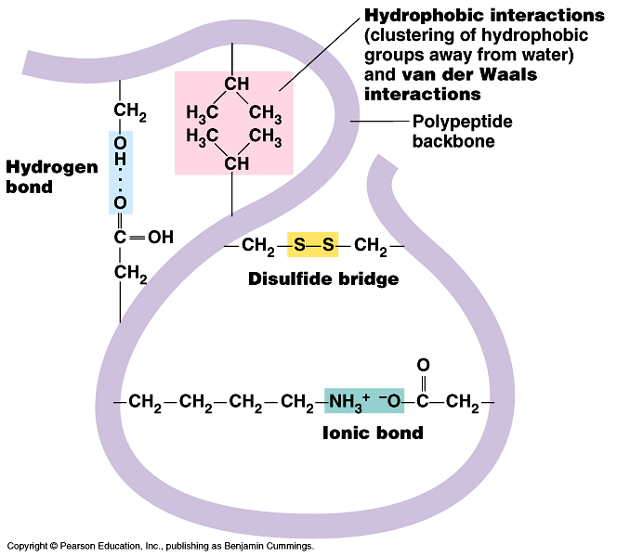
Examples of other interactions between individual amino acids

Slide 21
How do you separate and identify proteins from cell extracts?

Slide 22
How do you separate and identify proteins from cell extracts?

Slide 23
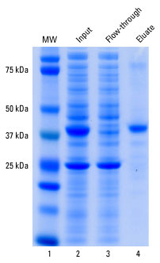
A
B

Slide 24
What determines the phenotype? (X2)
The proteins produced as a result of gene expression
Environmental factors

Slide 25
Mutations and genetic disorders
What is the outcome of a mutation?
DNA nucleotide sequence is altered.
What can be the effect of altered DNA sequence?
No protein or altered protein is being synthesised.
This is the cause of genetic disorders
What are the 2 main types of mutation?
Single gene mutation
Chromosome structure mutations

Slide 26
What are the 2 main types of mutation?
Single gene mutation
Chromosome structure mutations

Slide 27
Single gene mutations
What causes them?
Substitution
Insertion
Deletion

Slide 28
1/Substitution -Missense: one amino acid changed for another - Nonsense: results in premature stop codon - Splice-site: some intron being retained and/or some exon not being included
Single gene mutations

Slide 29
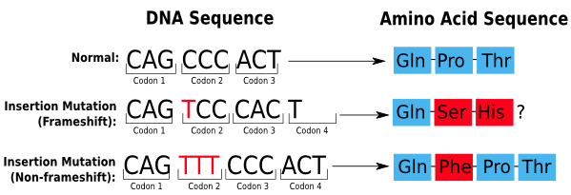
2/ Insertion/deletion Results (mostly) in frameshift mutations.
Single gene mutations

Slide 30
2/ Insertion/deletion Results (mostly) in frameshift mutations.
Single gene mutations
In what circumstances does an insertion or a deletion not result in a frameshift?

Slide 31
Insertion/deletion

Slide 32
Chromosome structure mutation
Four ways that the structure of a chromosome can be altered:
Deletion
Duplication
Inversion
Translocation

Slide 33
Deletion
Inversion
Translocation
Duplication

Slide 34
How do the effect of single gene mutation and chromosomal mutation compare?
Single gene mutations have an effect on the structure and function of proteins. This effect can be limited.
Chromosomal mutations result in substantial changes often lethal for the organism.

Slide 35
What is the difference in requirements for DNA and RNA synthesis?
Different enzymes: DNA and RNA polymerases
DNA polymerase cannot unwind and unzip double stranded DNA on its own, RNA polymerase can.
One in 4 nucleotides are different: Nucleotide carrying thymine for DNA is replaced by a nucleotide carrying uracil in RNA.
The strand produced remains bound to the template in DNA synthesis, the strand produced is free in the cytoplasm.

Slide 36
What are the similarities between DNA and RNA synthesis?
Both require a polymerase enzyme, albeit a different type
Both require free nucleotides
Both require ATP

