Slide 1
CB1-Practice of microscope questions

Slide 2
Problem solving about the microscope
Remember the logic and the basic facts!
The apparent size is much larger than the real size.
The overall magnification of a microscope can be calculated by timing the power of the lenses (NOT ADDING!)
If your answer has too many zeros, then you will be asked to change unit.
There is a lot of micrometers in a millimeter, therefore, to obtain micrometers from millimeters, you will have to convert that number of millimeters to a much bigger number, i.e. time it by 1000.
It is vice-versa to obtain a number of millimeters from micrometers, i.e. divide the number of micrometers by 1000.
The field of view is what you see through the microscope, sometimes you are given its diameter and that is very useful!
2mm

Slide 3
Typical questions will ask you any OR any combination of:
Finding the real size of the cell by using the real size of the field of view.
Calculating the total magnification from knowing the magnification of the individual lenses.
Calculating the total magnification by knowing the real size and the apparent size of the sample.
Converting millimeters to micrometers and vice-versa.
Lets practice those individually…...

Slide 4
Question: What is the length of one individual cell?
2mm
(Field of view)
Try it for yourself and find if your answer is correct next slide!

Slide 5
Question: What is the length of one individual cell?
2mm
(Field of view)
This cell has a length and a width
You can count how many length of cells fit in the field of view: 6
6 cells’ length fill up 2mm, so 1 cell length is: 2÷6= 0.3 mm
Width
Length
Did you get 0.18 mm? Be careful, you have not read the question properly or you
need to make sure you know the difference between length and width!

Slide 6
When you are not sure about setting up a calculation, you can always try to replace the numbers by simpler ones to handle:
For examples, if you were not sure whether you had to divide or time 2 by 6, imagine a similar question with simpler numbers to handle:
Now…... it is quite obvious that you have to divide 4 by 2 to obtain 2mm as the length of the cell!
4 mm
(Field of view)

Slide 7
Calculating the total magnification from knowing the magnification of the individual lenses.
Question: What is the total magnification of that microscope?
Eye piece lens: X10
Objective lens: X20
Try it for yourself and find if your answer is correct next slide!

Slide 8
Calculating the total magnification from knowing the magnification of the individual lenses.
Question: What is the total magnification of that microscope?
Eye piece lens: X10
Objective lens: X20
10X20= 200
The total magnification is X200
Did you get X30? Be careful, you have added the magnifications rather than
timing them!!!

Slide 9
Calculating the total magnification by knowing the real size and the apparent size of the sample.
Question: A yeast cell which real size is 1.25 mm appears to be
40 mm in length when looking through a microscope.
What is the total magnification of the microscope?
Try it for yourself and find if your answer is correct next slide!

Slide 10
Calculating the total magnification by knowing the real size and the apparent size of the sample.
Question: A yeast cell which real size is 1.25 mm appears to be
40 mm in length when looking through a microscope.
What is the total magnification of the microscope?
40 ÷ 1.5= 32
The total magnification is X32.
Where you unsure if you had to divide or multiply or what?
Go to the next slide, otherwise you can skip it!

Slide 11
Calculating the total magnification by knowing the real size and the apparent size of the sample.
Question: A yeast cell which real size is 1.25 mm appears to be
40 mm in length when looking through a microscope.
What is the total magnification of the microscope?
The cell has been enlarged by a certain number of times. So the calculation will be either divide or multiply one number by the other.
Remember the tip of changing the numbers by simple ones:
Imagine a yeast cell of 1mm that appears 40 mm, it is pretty obvious that it has been magnified 40 times. How would you get to 40 by a calculation? Only one way, divide the apparent size “40” by the real size “1”!

Slide 12
Converting millimeters to micrometers.
Question: Convert (1) 0.02 millimeters into micrometers and
(2) 350 micrometers in millimeters
Try it for yourself and find if your answer is correct next slide!

Slide 13
Converting millimeters to micrometers and vice-versa.
Question: Convert (1) 0.02 millimeters into micrometers and
(2) 350 micrometers in millimeters
Tip: in science, we like to deal with numbers with the least “000 or .000” as possible, so we convert numbers as soon as we have too many zeros!
A conversion done correctly will make an answer with less “0s” than the original number!
From millimeters to micrometer, you multiply by 1000.
From micrometer to millimeter you divide by 1000.
Now, try again!

Slide 14
Converting millimeters to micrometers and vice-versa.
Question: Convert (1) 0.02 millimeters into micrometers and
(2) 350 micrometers in millimeters
Tip: in science, we like to deal with small numbers and numbers with the least “000 or .000” as possible, so we convert numbers to a different unit as soon as the numbers are too big or we have too many zeros!
That means, a conversion done correctly will make an answer with less “0s” than the original number!
From millimeters to micrometer, you multiply by 1000.
From micrometer to millimeter you divide by 1000.

Slide 15
Converting millimeters to micrometers and vice-versa.
Question: Convert (1) 0.02 millimeters into micrometers and
(2) 350 micrometers in millimeters.
From millimeters to micrometer, you multiply by 1000:
0.02 X 100 = 20 μm
(2) From micrometer to millimeter you divide by 1000.
350 ÷ 100 = 0.3 μm

Slide 16
Real-life questions are often a combination of
the skills that you have learnt!
The order of the calculations
does not matter!

Slide 17
Question 1.
Question: A microscope has a X4 eye piece lens and a X100 objective lens. A cell’s length is 0.2μm, what will be its apparent size?
Break down the problem in 3 steps.

Slide 18
Question 1.
Question: A microscope has a X4 eye piece lens and a X100 objective lens. A cell’s length is 0.02μm, what will be its apparent size in mm?
The 3 steps for this question are:
- finding out the total magnification
- finding the size of the apparent length from the actual size and the magnification
- converting the result from μm to mm.

Slide 19
Question 1.
Question: A microscope has a X40 eye piece lens and a X100 objective lens. A cell’s length is 2μm, what will be its apparent size in mm?
finding out the total magnification
40X100 = X4000
Finding the apparent length from the actual size and the magnification
(Apparent size always expected to be bigger)
2X4000 = 8000μm
- converting the result from μm to mm.
(Get rid of extra “0s”, can only be done by dividing the number)
8000 ÷ 1000 = 8mm

Slide 20
Question 2.
Question: A microscope has a X2 eye piece lens and a X10 objective lens. Five length of cells fit in the field of view with a diameter of 3mm. What is the apparent length of 1 cell in mm?
First, break down the problem in 3 steps.

Slide 21
Question 2.
Question: A microscope has a X2 eye piece lens and a X10 objective lens. Five length of cells fit in the field of view with a diameter of 3mm. What is the apparent length of 1 cell?
The 3 steps for this question are:
- finding out the total magnification
- finding the real size of one cell from the number of cells that can fit in the diameter of he field of view.
- finding what would be the apparent size of that cell when taking into account the magnification

Slide 22
Question 2.
Question: A microscope has a X2 eye piece lens and a X10 objective lens. Five length of cells fit in the field of view with a diameter of 3mm. What is the apparent length of 1 cell?
The 3 steps for this question are:
- finding out the total magnification
- finding the real size of one cell from the number of cells that can fit in the diameter of he field of view.
- finding what would be the apparent size of that cell when taking into account the magnification

Slide 23
Question 2.
Question: A microscope has a X2 eye piece lens and a X10 objective lens. Five length of cells fit in the field of view with a diameter of 3mm. What is the apparent length of 1 cell?
finding out the total magnification:
2 X 10 = X20
finding the real size of one cell from the number of cells that can fit in the diameter of he field of view.
3 ÷ 5 = 0.6 mm
finding what would be the apparent size of that cell when taking into account the magnification
0.6 X 20 = 12 mm

Slide 24
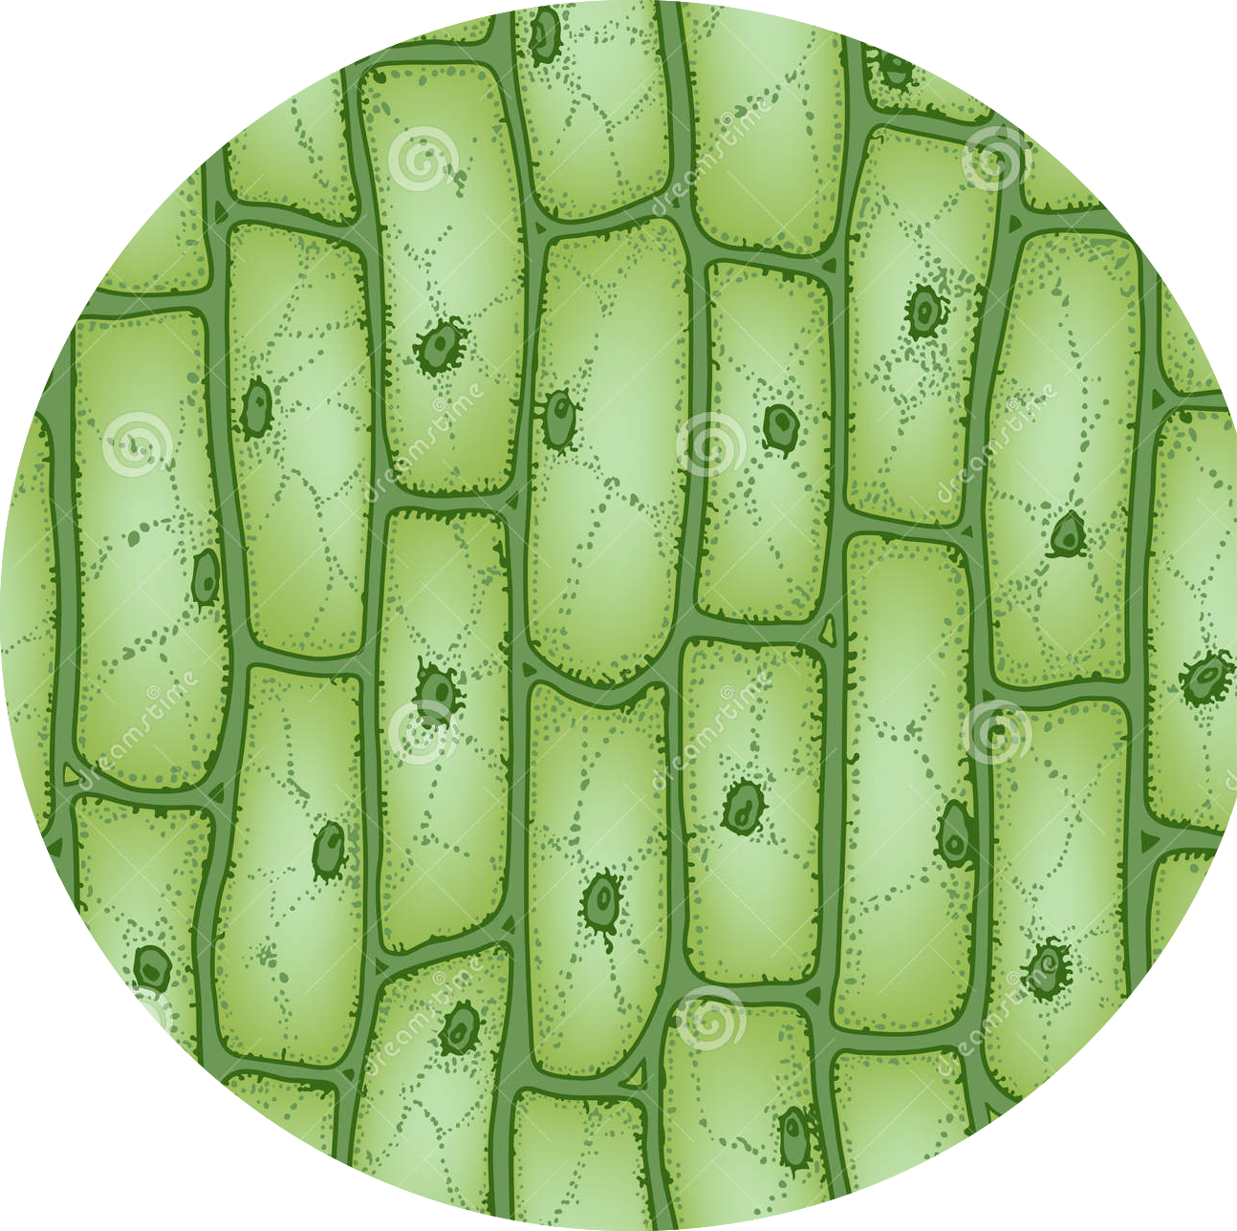
Question 3.
Question: estimate the average length of
a cell.
0.2 μm
First, breakdown the problem in 2 steps.

Slide 25
Question 3.
Question: estimate the average length of
a cell.
0.2 μm
Finding the diameter of the field of view:
0.2 X 5 = 1 mm
Estimating the diameter of one cell:
1 ÷ 3 = 0.3 mm

Slide 26
Question 4.
Question: if a cell appear to be 10mm in length when looking through a microscope which magnifies by X300,
what is its actual size in μm.
First, breakdown the problem in 2 steps.

Slide 27
Question 4.
Question: if a cell appear to be 10mm in length when looking through a microscope which magnifies by X300,
what is its actual size in μm.
Finding how much smaller is the actual size of the cell?
10 ÷ 300 = 0.3 mm
Converting the answer to μm:
0.3 X 1000 = 300 μm

