Slide 1
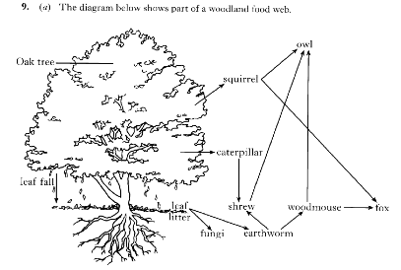
1
LE4- Energy in ecosystems

Slide 2
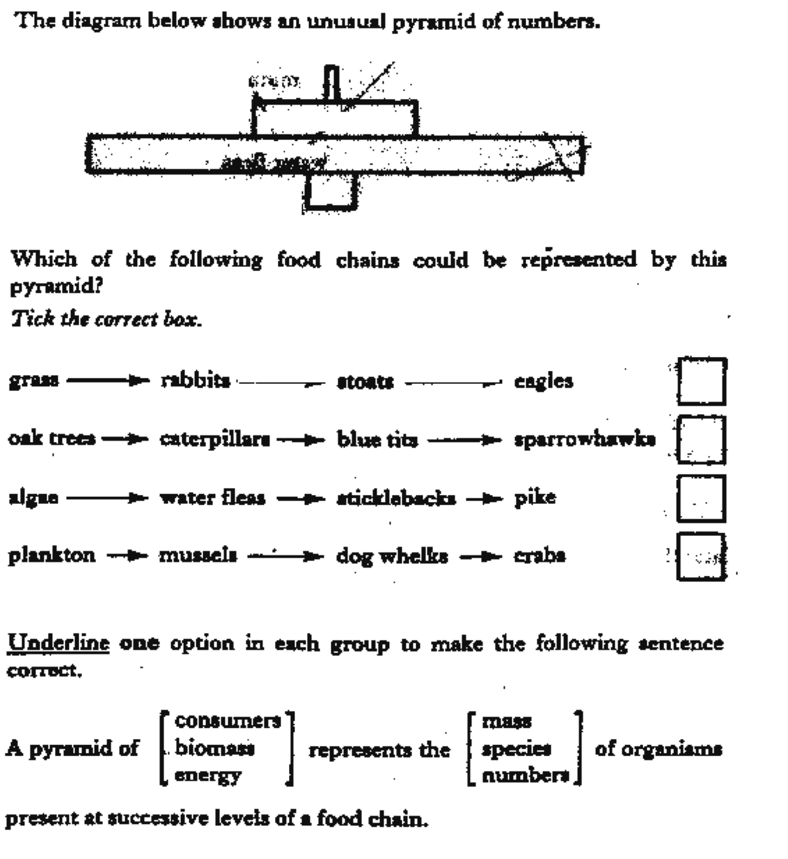
2

Slide 3
3
4
5

Slide 4
6

Slide 5
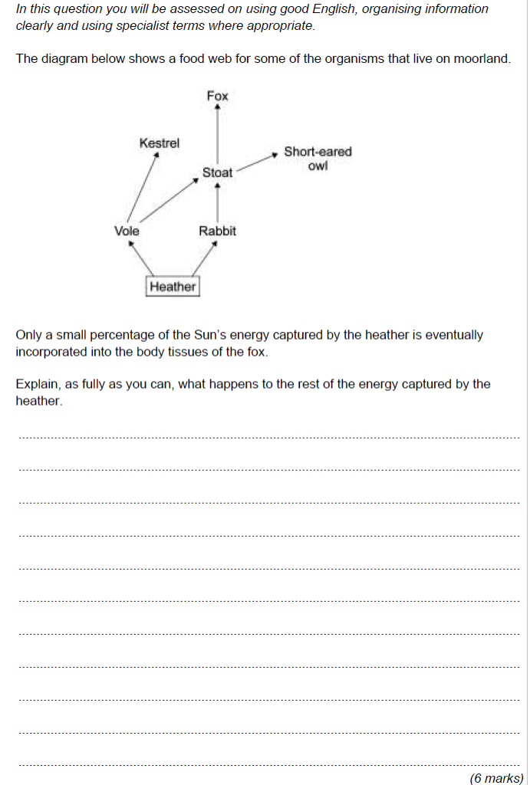
7

Slide 6
