Slide 1
Can you remember the differences between : - multipotent/pluripotent stem cells (and name examples)? - somatic/germline cells? - mitosis/meiosis?

Slide 2
Cellular differentiation What is it and what causes it?
It is the process by which a cell expresses certain genes to produce proteins characteristic for that type of cell.

Slide 3
Cellular differentiation What is it?
A process by which a cell acquires special features to carry out a specialised function.
It is the process by which a cell expresses certain genes to produce proteins characteristic for that type of cell.

Slide 4
Cellular differentiation What causes it?
The cell expresses certain genes to produce proteins characteristic for that type of cell.

Slide 5
Structure of DNA and DNA replication

Slide 6
Structure of DNA
What is determined by the sequence of DNA?
The genotype

Slide 7
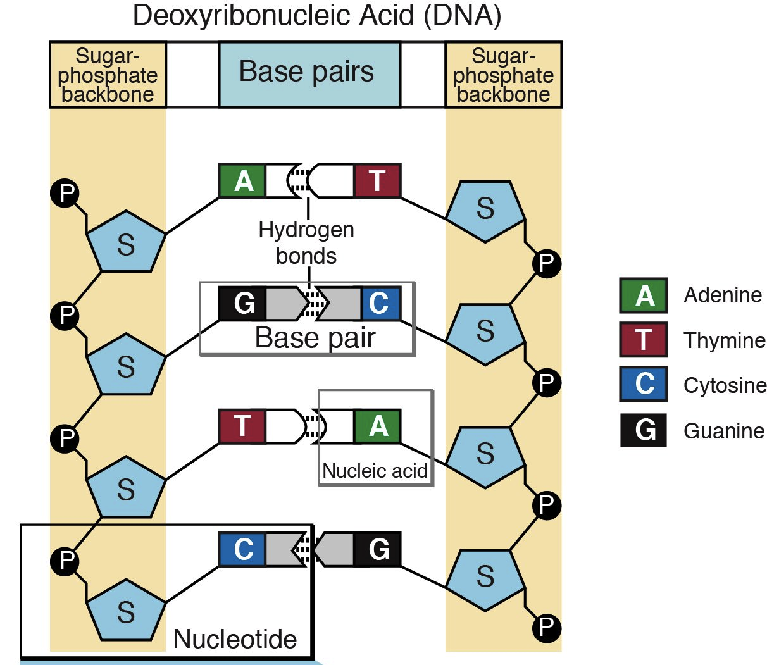
What is wrong in that slide?
1
1
A base has been labelled “nucleic acid”.
9
2
10
5
3
6
7
11
8
A nucleic acid is a large molecule made of repeated units called nucleotides (e.g. DNA and RNA)
12
4

Slide 8
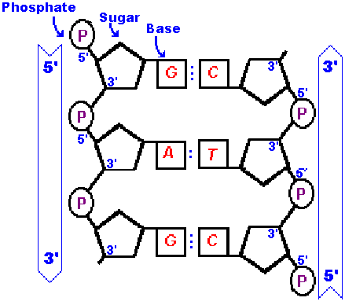
What feature of DNA is shown in this slide?
The two strands of DNA have an anti-parallel structure

Slide 9
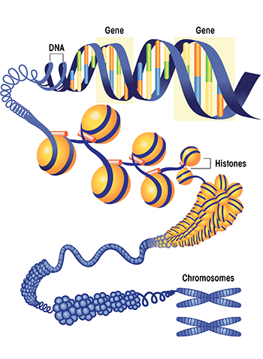
1
1
2
Chromosomes consist of tightly coiled DNA and are packaged with associated proteins
Proteins
3
4

Slide 10
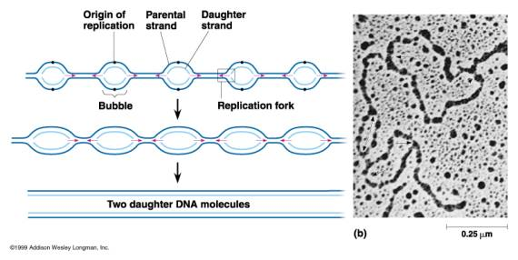
Is DNA replication taking place before or during cell division?
Before
Which enzyme is responsible for DNA replication?
DNA polymerase
DNA replication occurs at several locations on a DNA molecule,
True or false?
TRUE!

Slide 11
DNA replication
5’
3’
5’
A
T
3’
A
T
DNA unwinds
C
G
G
C
T
A
G
C
G
C
A
T
C
G
A
T
T
A
C
G
G
C
A
T
T
3’
A
5’
3’
5’

Slide 12
DNA replication
5’
3’
5’
A
T
3’
Hydrogen bonds break and the DNA 2 template strands are formed
A
T
C
G
G
C
T
A
G
C
G
C
A
T
C
G
A
T
T
A
G
C
3’
C
G
3’
T
A
5’
5’
A
T

Slide 13
DNA replication
5’
3’
5’
A
T
3’
Correct?
A
T
C
G
G
C
T
A
G
C
G
C
A
T
C
G
A
T
T
A
G
C
3’
C
G
3’
T
A
5’
5’
A
T

Slide 14
DNA replication
Why?
5’
3’
5’
A
T
3’
A
T
C
G
G
C
T
A
G
C
G
C
A
T
C
G
A
T
T
A
G
C
3’
C
G
3’
T
A
5’
5’
A
T

Slide 15
DNA replication – leading strand
5’
3’
5’
A
T
3’
A primer binds to the DNA
A
T
C
G
G
C
T
A
G
C
G
C
A
T
C
G
A
T
T
A
G
C
C
5’
G
3’
G
3’
3’
T
C
A
5’
A
T
5’
A
T
G
T
A
5’
C
T
3’
A

Slide 16
DNA replication – leading strand
5’
3’
5’
A
T
3’
A primer binds to the DNA
A
T
C
G
G
C
T
A
G
C
G
C
A
T
C
G
A
T
T
A
G
C
C
G
3’
G
3’
T
A
5’
A
A
T
T
G
C
T
A

Slide 17
DNA replication – leading strand
5’
A
T
3’
A
T
DNA polymerase adds nucleotides to the 3’ end of the primer
C
G
G
C
T
A
G
C
G
C
A
T
C
G
A
T
T
A
G
C
C
C
G
3’
T
G
A
A
5’
A
T
G
T
C
T
A

Slide 18
DNA replication – leading strand
5’
A
T
3’
A
T
DNA polymerase catalyses the formation of a chemical bond between nucleotides
C
G
G
C
T
A
G
C
G
C
A
T
C
G
A
T
T
A
G
C
C
C
G
3’
T
G
A
A
5’
A
T
G
T
C
T
A

Slide 19
DNA replication – leading strand
5’
A
T
3’
A
T
DNA polymerase adds nucleotides to the 3’ end of the growing strand
C
G
G
C
T
A
G
C
G
C
A
T
C
G
A
T
T
A
G
A
C
C
C
G
3’
T
G
A
A
5’
A
T
G
T
C
T
A

Slide 20
DNA replication – leading strand
5’
A
T
3’
A
T
DNA polymerase adds nucleotides to the 3’ end of the growing strand
C
G
G
C
T
A
G
C
G
C
A
T
C
T
G
G
A
T
T
T
A
A
G
C
C
C
G
3’
T
G
A
A
5’
A
T
G
T
C
T
A

Slide 21
DNA replication – leading strand
5’
A
T
3’
A
T
This process is repeated until the entire molecule is replicated
C
G
G
C
T
A
G
A
C
C
C
G
A
C
T
C
T
G
G
A
T
T
T
A
A
G
C
C
C
G
3’
T
G
A
A
5’
A
T
G
T
C
T
A

Slide 22
DNA replication – lagging strand
5’
A
T
3’
A primer binds to the DNA once it is exposed
A
T
C
G
G
C
T
A
G
C
G
C
A
T
C
G
A
T
T
A
A
G
T
C
C
G
G
3’
T
A
5’
A
G
T
C
T
A

Slide 23
DNA replication – lagging strand
5’
A
T
3’
A
T
DNA polymerase adds nucleotides to the 3’ end of the primer
C
G
G
C
T
A
G
C
G
C
A
T
C
G
A
T
T
A
A
G
T
C
C
G
G
3’
T
A
5’
A
G
T
C
T
A

Slide 24
DNA replication – lagging strand
5’
A
T
3’
A
T
DNA polymerase adds nucleotides to the 3’ end of the growing strand
C
G
G
C
T
A
G
C
G
C
A
T
C
G
A
T
T
A
A
G
T
C
C
G
G
3’
T
C
A
A
T
5’
G
C
T
A

Slide 25
DNA replication – lagging strand
5’
A
T
3’
DNA polymerase adds nucleotides to the 3’ end of the growing fragment
A
T
C
G
G
C
T
A
G
T
C
G
C
G
A
T
A new primer is added to exposed DNA
C
G
A
T
T
A
A
G
T
C
C
G
G
3’
T
C
A
A
T
T
5’
G
A
C
T
A

Slide 26
DNA replication – lagging strand
5’
A
T
3’
A
T
DNA polymerase adds nucleotides to the 3’ end of the primer
C
G
G
C
T
A
G
T
C
G
C
G
A
G
T
C
G
A
T
T
A
A
G
T
C
C
G
G
3’
T
C
A
A
T
T
5’
G
A
C
T
A

Slide 27
DNA replication – lagging strand
5’
A
T
3’
A
T
DNA polymerase catalyses the formation of a chemical bond between nucleotides
C
G
G
C
T
A
G
T
C
G
C
G
G
A
T
C
G
A
T
T
A
A
G
T
C
C
G
G
3’
T
C
A
A
T
T
5’
G
A
C
T
A

Slide 28
DNA replication – lagging strand
DNA polymerase adds nucleotides to the 3’ end of the growing fragment until it reaches the previous one
5’
A
T
3’
A
T
C
G
G
C
T
A
G
T
C
G
C
G
G
A
T
C
A
G
A
C
T
T
A
A
G
T
C
C
G
G
3’
T
C
A
A
T
T
5’
G
A
C
T
A

Slide 29
DNA replication – lagging strand
5’
A
T
3’
A
T
The primer is replaced by DNA
C
G
G
C
T
A
G
T
C
G
C
G
G
A
T
C
A
G
A
C
T
T
A
A
G
T
C
C
G
G
3’
T
C
A
A
T
T
5’
G
A
C
T
A

Slide 30
DNA replication – lagging strand
5’
A
T
3’
A
T
DNA ligase joins the fragments together
C
G
G
C
T
A
G
T
C
G
C
G
G
A
T
C
A
G
A
C
T
T
A
A
G
T
C
C
G
G
3’
T
C
A
A
T
T
5’
G
A
C
T
A

Slide 31
DNA replication – lagging strand
5’
A
T
3’
As the DNA opens more, another fragment will be made and connected to the previous one.
A
T
C
G
G
C
T
A
G
T
C
G
C
G
G
A
T
C
A
G
A
C
T
T
A
A
G
T
C
C
G
G
3’
T
C
A
A
T
T
5’
G
A
C
T
A

Slide 32
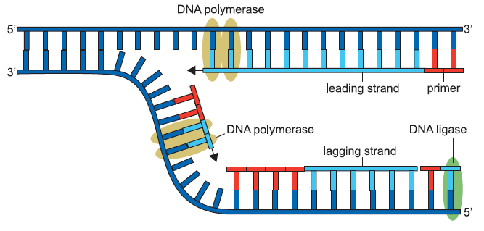

Slide 33
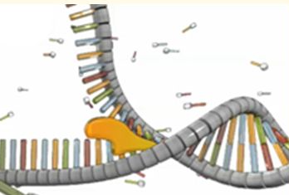
What first step is needed to obtain two template strands?
DNA is unwound

Slide 34
More on leading and lagging strands, but video omits to mention primers
https://www.youtube.com/watch?v=wCKF-2nqaOc

Slide 35
What 6 requirements for DNA synthesis?
1- Template DNA strand
2- Primers = short sequence of nucleotides (Polymerase can only extend existing strand)
3- Free nucleotides
4- ENERGY (ATP)
5- DNA polymerase
6- DNA ligase

