Slide 1
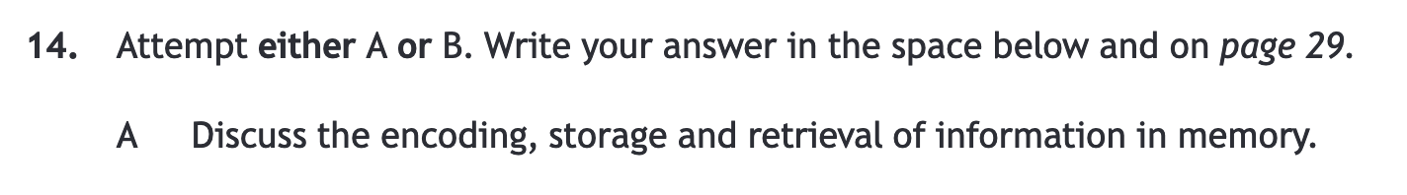
Higher Human- 2019

Slide 2
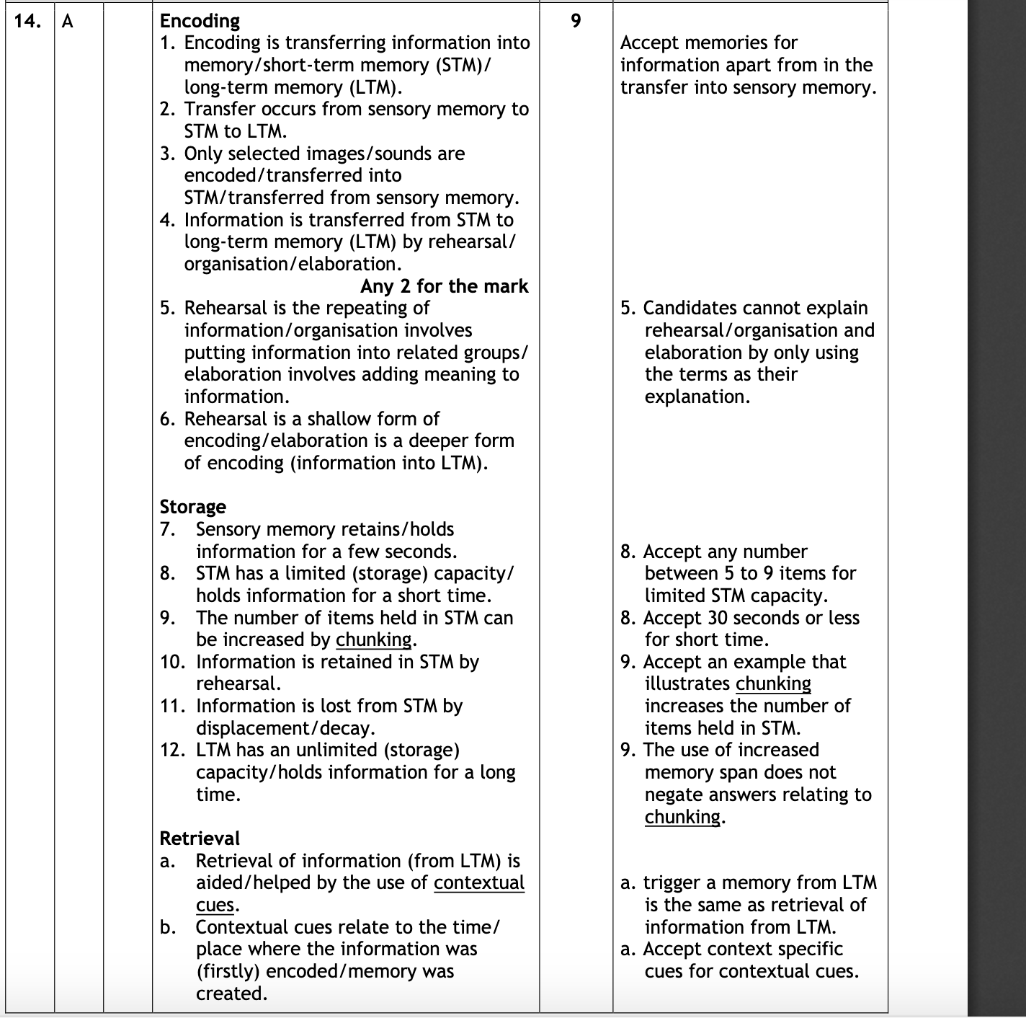
Higher Human- 2019

Slide 3

Higher Human- 2019

Slide 4
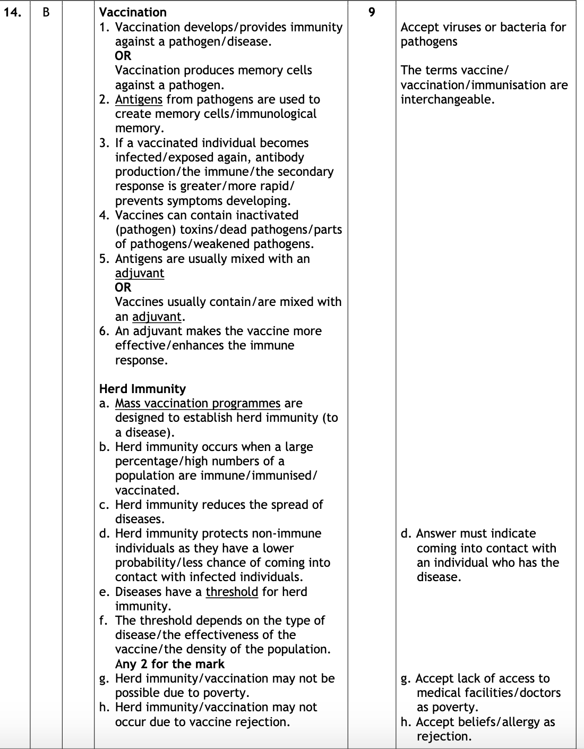
Higher Human- 2019

Slide 5
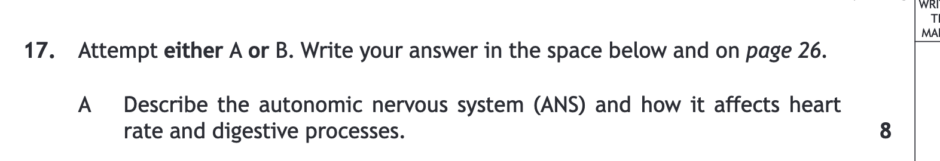
Higher Human paper -2018

Slide 6
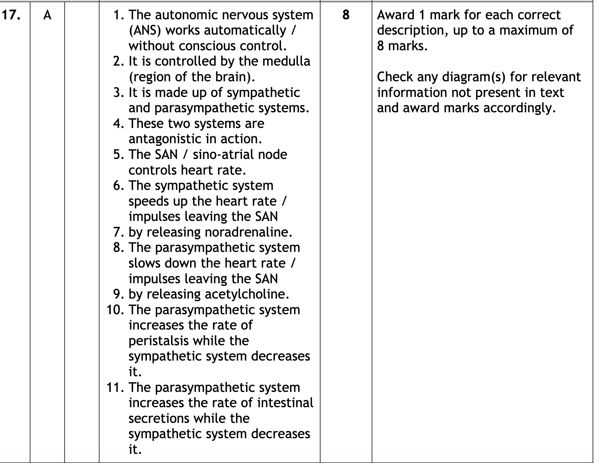
Current Higher Human-Specimen paper -2018

Slide 7
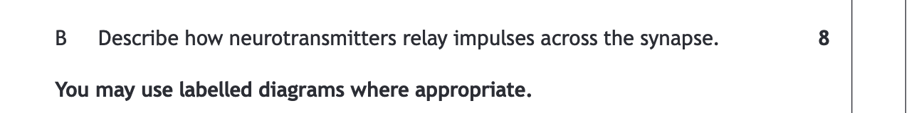
Current Higher Human-Specimen paper -2018

Slide 8
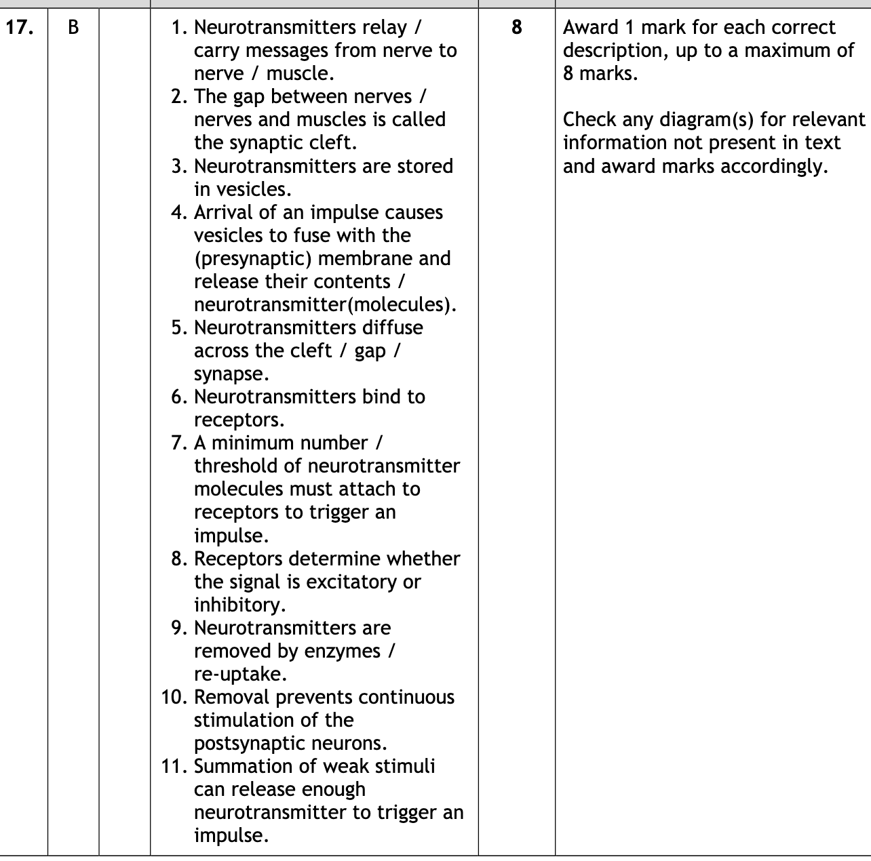
Current Higher Human-Specimen paper -2018

Slide 9


Higher Human -2018

Slide 10
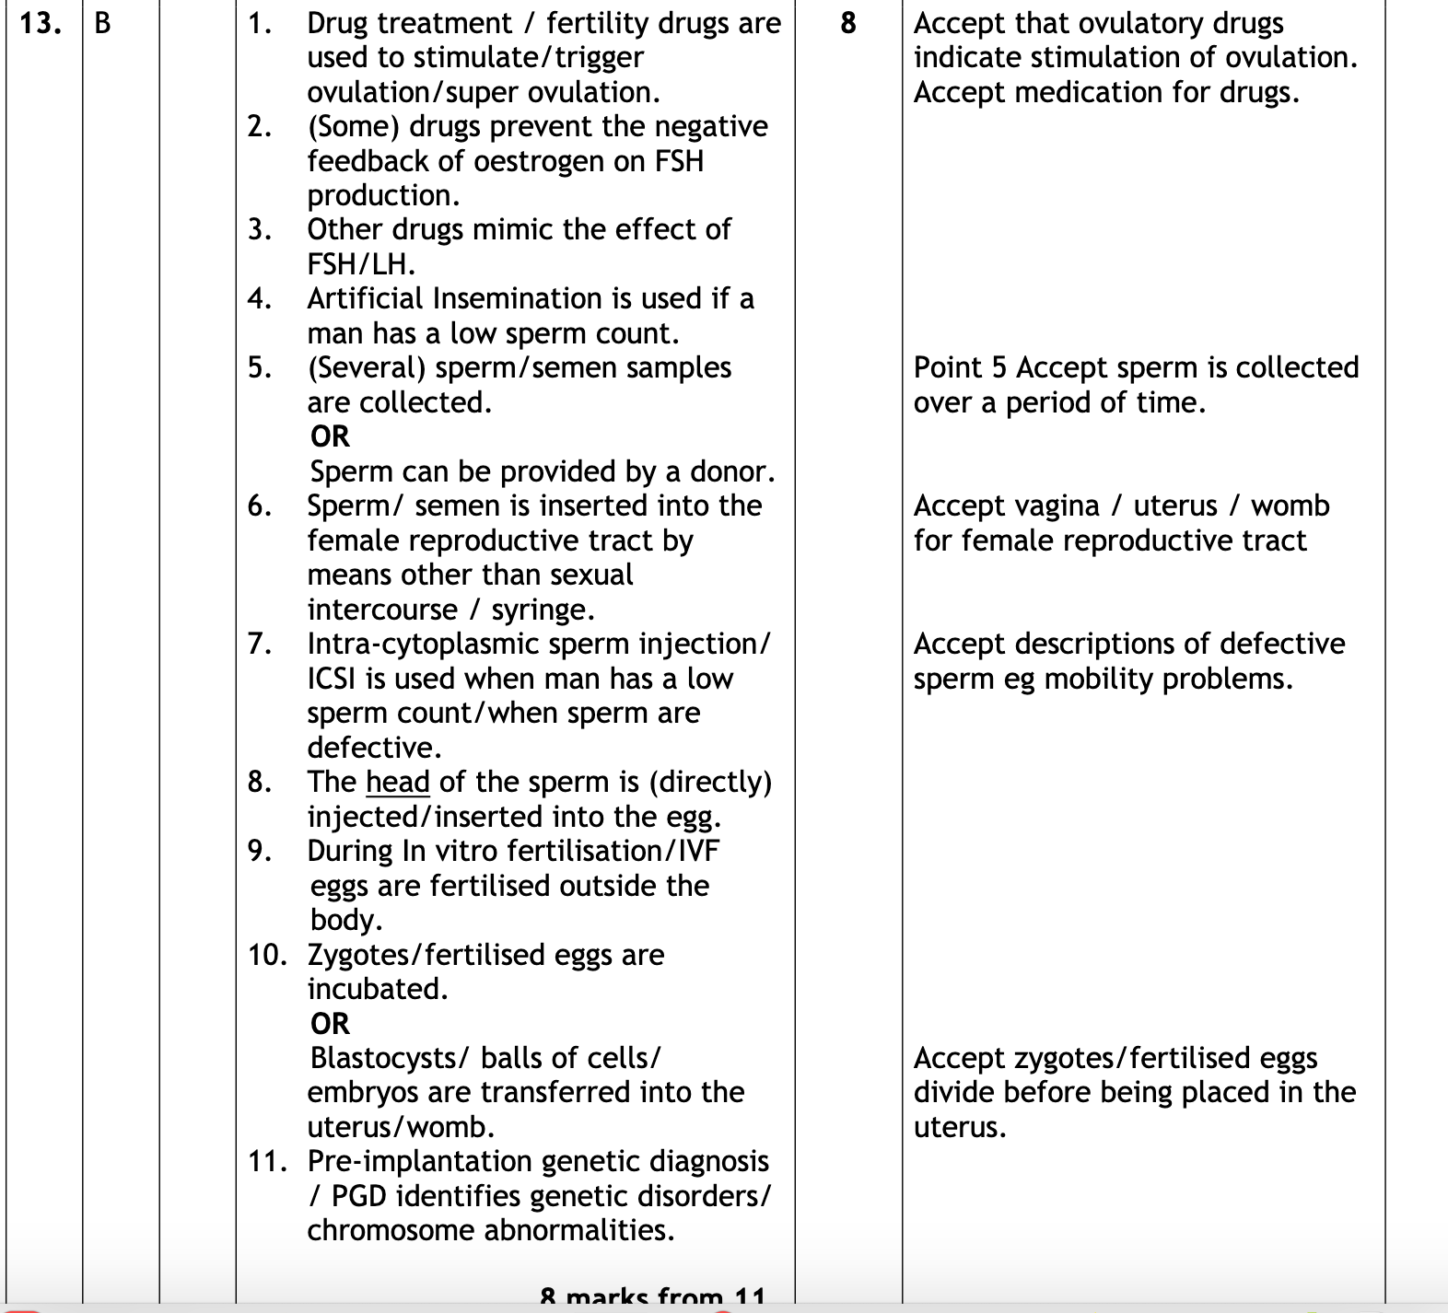

Slide 11
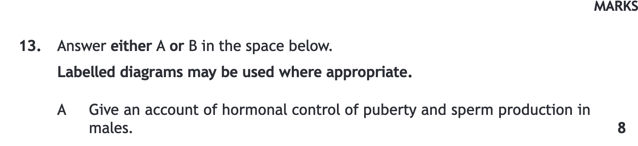
Higher Human -2018

Slide 12
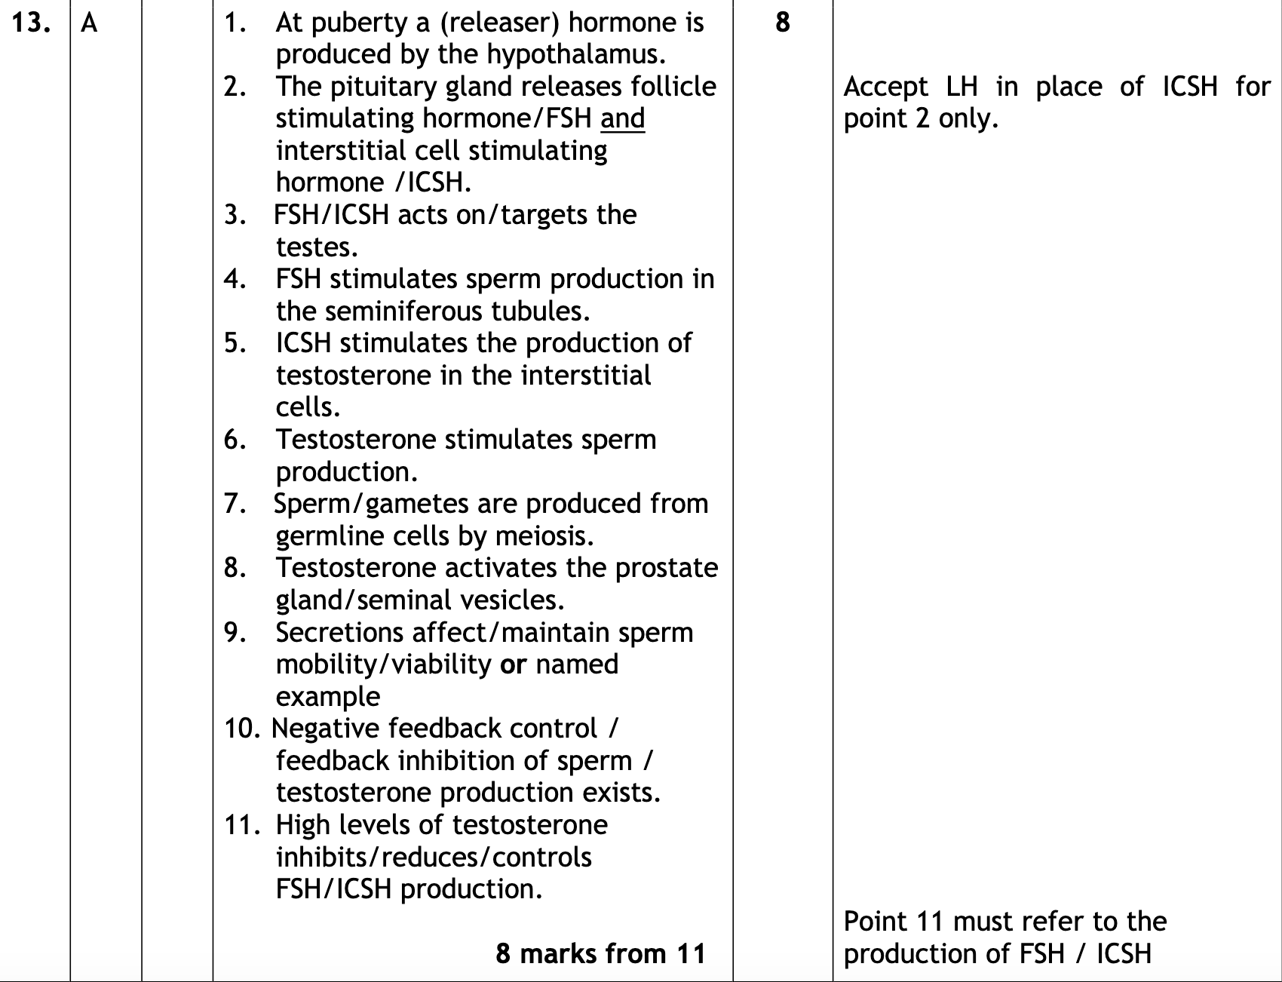

Slide 13
Higher Human -2017

Slide 14
Higher Human -2017

Slide 15
Higher Human -2017

Slide 16
Higher Human -2017

Slide 17
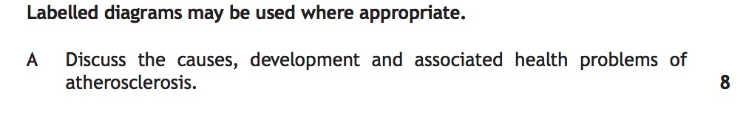
Higher Human -2016

Slide 18
Higher Human -2016

Slide 19
Higher Human -2016

Slide 20
Higher Human -2016

Slide 21
Higher Human -2015

Slide 22
Higher Human -2015

Slide 23
Higher Human -2015

Slide 24
Higher Human
-2015

Slide 25
Higher Human –Specimen paper

Slide 26
Higher Human –Specimen paper

Slide 27
Current Higher Human –Specimen paper

Slide 28
Higher Human –Specimen paper

Slide 29
Higher Human – Exemplar paper

Slide 30
Higher Human – Exemplar paper

Slide 31
Higher Human – Exemplar paper

Slide 32
Higher Human – Exemplar paper

Slide 33
Revised Higher Human – 2015 – Essay 1A

Slide 34
Revised Higher Human – 2015 – Essay 1A

Slide 35
Revised Higher Human – 2015 – Essay 1B

Slide 36
Revised Higher Human – 2015 – Essay 1B

Slide 37
Revised Higher Human – 2014 – Essay 1A

Slide 38
Revised Higher Human – 2014 – Essay 1A

Slide 39
Revised Higher Human – 2014 – Essay 1B

Slide 40
Revised Higher Human – 2014 – Essay 1B

Slide 41
Revised Higher Human – 2014 – Essay 2A

Slide 42
Revised Higher Human – 2014 – Essay 2A

Slide 43
Revised Higher Human – 2014 – Essay 2B

Slide 44
Revised Higher Human – 2014 – Essay 2B

Slide 45
Revised Higher Human – 2013 – Essay 1A

Slide 46
Revised Higher Human –
2013 – Essay 1A

Slide 47
Revised Higher Human –
2013 – Essay 1B

Slide 48
Revised Higher Human –
2013 – Essay 1B

Slide 49
Revised Higher Human –
2013 – Essay 2A

Slide 50
Revised Higher Human –
2013 – Essay 2A

Slide 51
Revised Higher Human –
2013 – Essay 2B

Slide 52
Revised Higher Human –
2013 – Essay 2B

Slide 53
Revised Higher Human –
2012 – Essay 1B

Slide 54
Revised Higher Human –
2012 – Essay 1B

Slide 55
Revised Higher Human –
2012 – Essay 2A

Slide 56
Revised Higher Human –
2012 – Essay 2A

Slide 57
Revised Higher Human –
2012 – Essay 2B

Slide 58
Revised Higher Human –
2012 – Essay 2B

Slide 59
Old Higher Human –
2012 – Essay 1B

Slide 60
Old Higher Human –
2012 – Essay 1B

Slide 61
Old Higher Human –
2012 – Essay 2A

Slide 62
Old Higher Human –
2012 – Essay 2A

Slide 63
Old Higher Human –
2012 – Essay 2B

Slide 64
Old Higher Human –
2012 – Essay 2B

Slide 65
Old Higher Human –
2010 – Essay 1A

Slide 66
Old Higher Human –
2010 – Essay 1A

Slide 67
Old Higher Human –
2010 – Essay 2A

Slide 68
Old Higher Human –
2010 – Essay 2A

Slide 69
Old Higher Human –
2010 – Essay 2B

Slide 70
Old Higher Human –
2010 – Essay 2B

